Slide 1

The elements of visual image
By Mtra. Zinnia Quiñones Urióstegui
Marzo 2014
http://www.uaeh.edu.mx/virtual

Slide 2
The elements of visual image
Design Elements
Design Principles
Line
Shape
Form
Space
Color
Texture
Balance
Variety
Movement
Contrast
Emphasis
Proportion
Unity

Slide 3
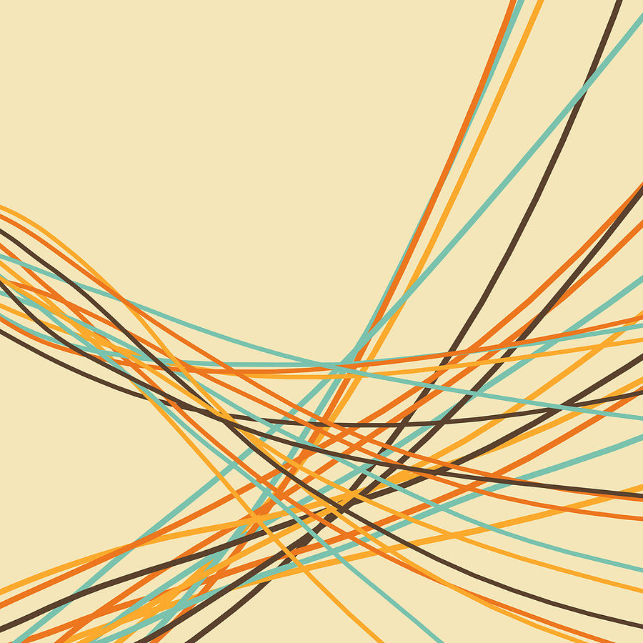
Line
A path of a moving point trough space

Slide 4
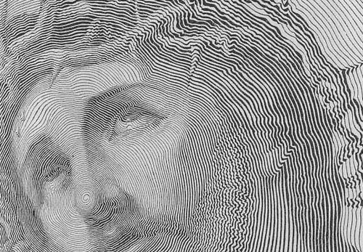
Line
Can differ in:
  Length
  Width
  Texture
  Direction
5 kinds of lines
  Straight
  Curved
  Zigzag
Engraving ,1844

Slide 5
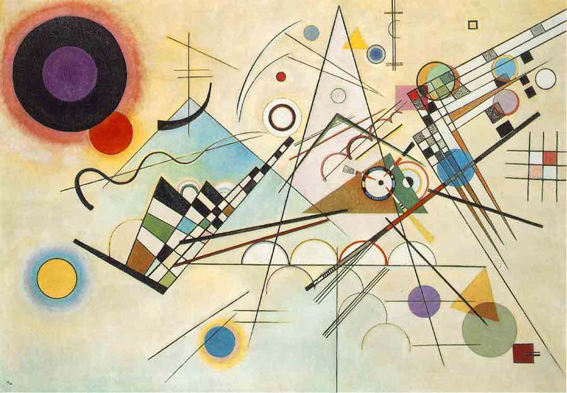
Shape
A two dimensional area that is defined in some way.

Slide 6
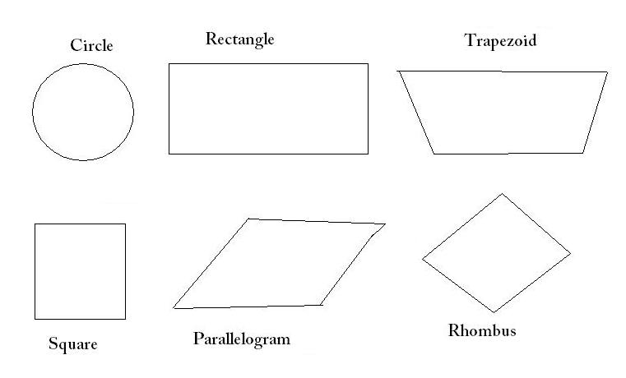
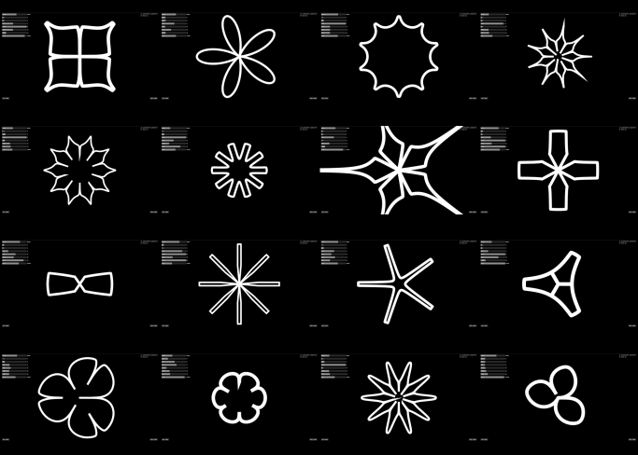
Shape
Geometrical shapes
  Square
  Rectangle
  Circle triangle
  Any shape with width & height,
Organic: free forms shapes, shapes in nature
Forms made by accidental action

Slide 7
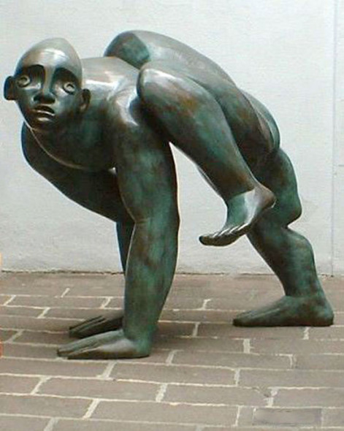
FORM
A tree-dimensional object that has
  Height
  width
  Depth
  Or a two-dimensional graphic work than appear to be a tree-dimensional object
For example: a triangle, which is a 2 dimensional is a shape, but a pyramid, which is a 3 –dimensional, is a form.

Slide 8
Shapes and forms
Are defined by space around and within tem.
Positive space
Negative sp
Space
Space in 2d work can be found as
Background
Middleground
foreground

Slide 9
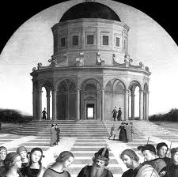
Space
Refers to the emptiness or area between, around, above, below, or within objects

Slide 10
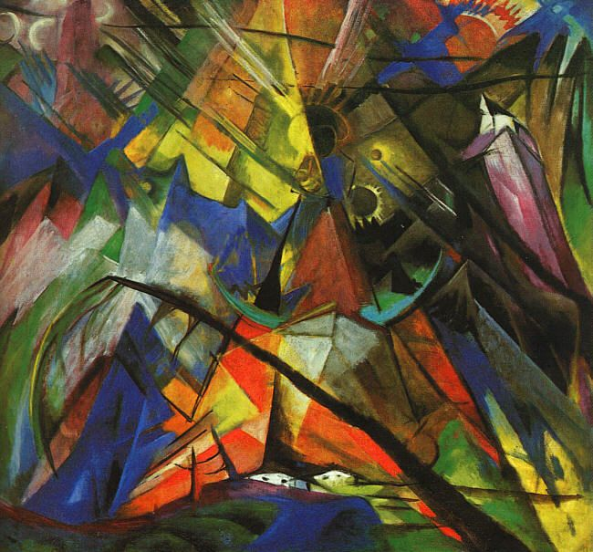
color
An element of art that is driven form reflected light.

Slide 11
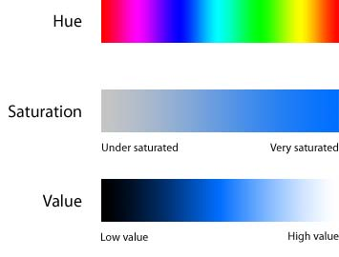
Properties of color
Hue- the name of a color, like red, blue, black…
Value- lightness or darkness of a color
Intensity- the brightness or a dullness of a color

Slide 12
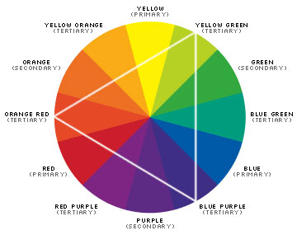
color
Primary Colors
Secondary Colors
Warm an cool colors
Warm- red. Orange, yellow
Cool- green, blue, violet

Slide 13
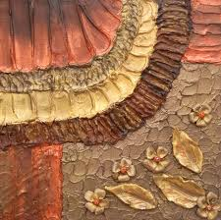
TEXTURE
Refers to how things feel or look as if the might feel if touched

Slide 14
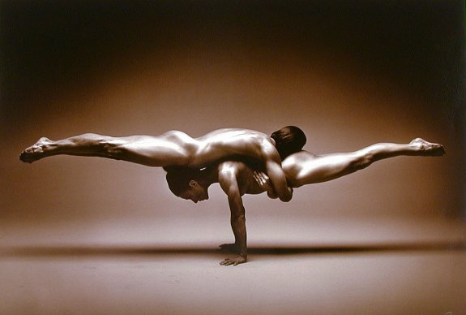
balance
An appearance of evenness, refers to the distribution of visual weight in an artwork.

Slide 15
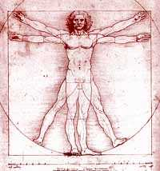
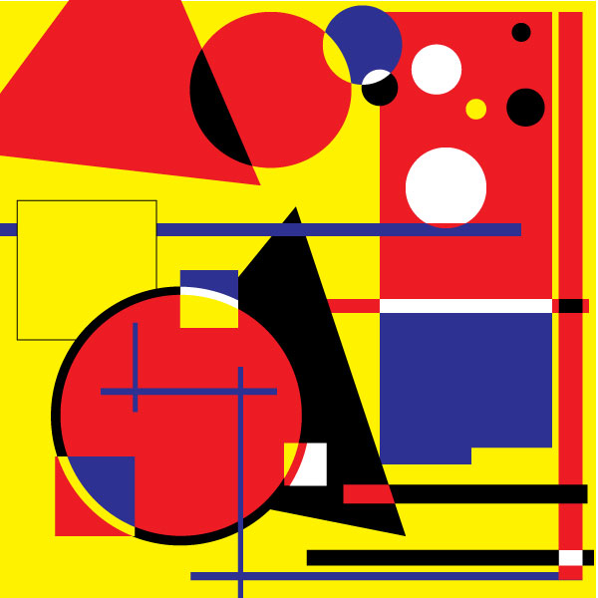
BALANCE
There are two kinds:
  Symmetry. In composition it is an arrangement of elements using order or disorder
    Symmetry: vertical & horizontal, radial
Asymmetry. In composition with a heavy an light amount of elements. Asymmetry uses disorder to create valance.

Slide 16
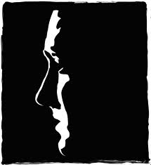
CONTRAST
A large difference between elements. Green and red, dark and light, large and small, thin an thick, bright and dull.

Slide 17
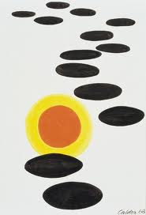
emphasis
Where an artist draws attention to one or more parts of a design
Is used by artists to create dominance and focus in their work. Artists often uses focal areas (centers of interest to place emphasis on the most important aspect of art.

Slide 18
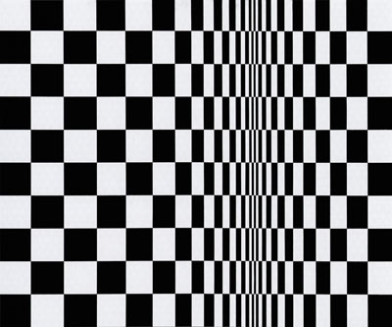
Movement
The path the viewer's eye is directed to take by the artist’s choice of elements such as line

Slide 19
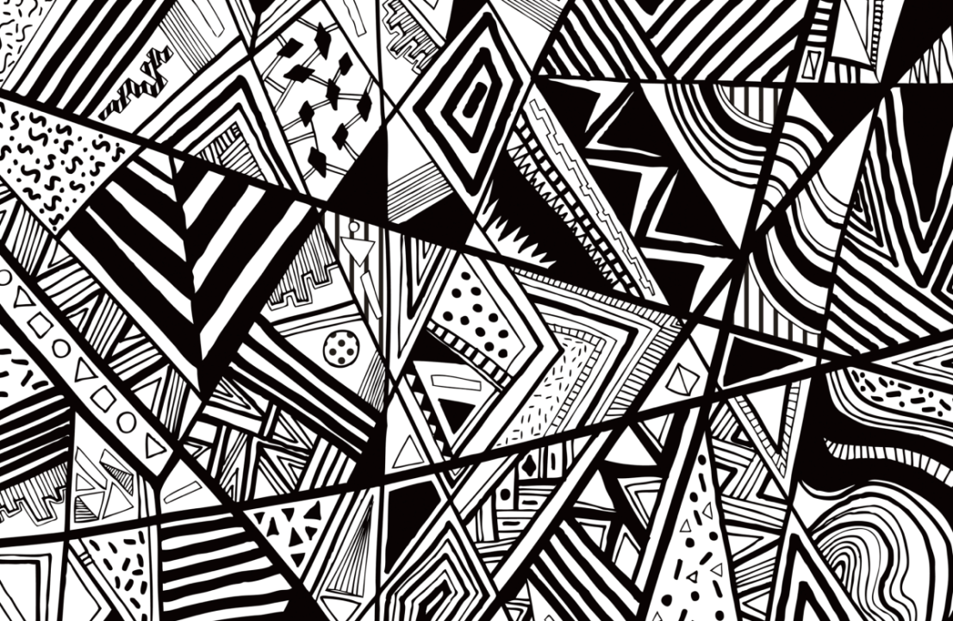
variety
The differences in any element in a work of art give in variety

Slide 20
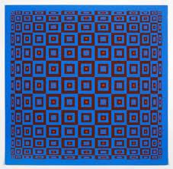
rhythm
Is repetition of visual movement of the elements: colors, shapes, lines, values, forms, spaces and textures. Movement and rhythm work together to create the visual equitant of a musical beat…

Slide 21
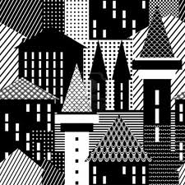
Pattern
Pattern uses the art elements in planned or random repetitions to enhance surfaces of any artwork

Slide 22
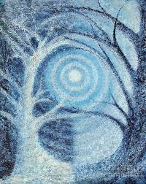
UNITY
A sense that all of the parts belong together as one piece of artwork
Provides the cohesive quality than makes an art work feel complete and finished. All the principles work together to create unity and therefore a successful design.

Slide 23
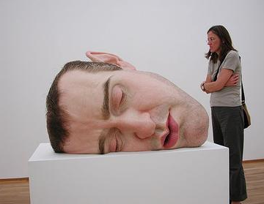
PROPORTION AND SCALE
The relationships of size in artworks in a relation to how they are normally viewed

Slide 24
references
Aumont, J. (1992). La imagen, Barcelona, Paidós
Dondis, D.A .(1990)La sintaxis de la imagen, una introducción al alfabeto visual. Barcelona, Gustavo Gili

Slide 25
Colaborador: Mtra en C.D. Zinnia Quiñones Urióstegui
Nombre de la asignatura: Expresión y Apreciación del Arte
Programa Educativo: Bachillerato Virtual

