Slide 1
Universidad Autónoma del Estado de Hidalgo
Escuela Preparatoria Número Tres
Área Académica de Arte y literatura
Ene-Jun-2017
Materia: Arte Mexicano
Unidad: VIII “EL SIGLO XX”
Tema: 8.1.4 La pintura
8.1.4.6. Frida Kahlo
Catedrática: Mtra. Ma. Del Rosario Cortés Nájera

Slide 2
Objetivo
Caracterizar cada obra de arte generada desde las culturas prehispánicas y las corrientes artísticas surgidas a través de la historia de nuestro país, a partir de una perspectiva analítica, crítica y reflexiva que le permita valorar el arte como manifestación de la belleza y expresión de ideas y emociones a través de su tiempo.

Slide 3
Competencias
Es sensible al arte y participa en la apreciación e interpretación de sus expresiones en distintos géneros.

Slide 4
Contenido
Unidad VIII “EL SIGLO XX”
8.1.4 La pintura
8.1.4.6. Frida Kahlo

Slide 5
Frida Kahlo
Biografia
Biography

Slide 6
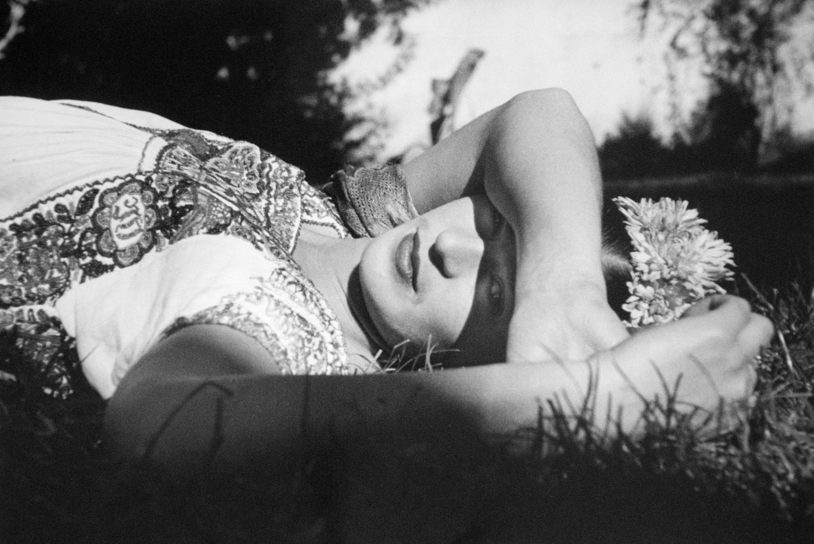
"I never paint dreams or nightmares.
I paint my own reality."
Foto: Frida en el jardín, Xochimilco, México, ca. 1941. © Fundación Leo Matiz

Slide 7
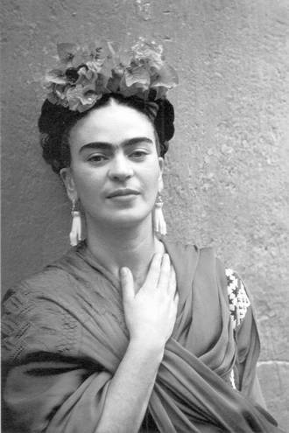
She is Frida Kahlo
Magdalena Carmen Frida Kahlo Calderón
Was born on July 6, 1907, in Coyoacán, Mexico City, Mexico.

Slide 8
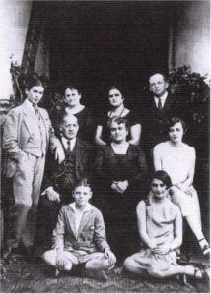
Her father, Guillermo Kahlo (1871–1941), was born Carl Wilhelm Kahlo in Pforzheim, Germany.
Frida's mother, Matilde Calderón y Gonzalez, was a devout Roman Catholic of primarily Amerindian, as well as Spanish, ancestry.[

Slide 9
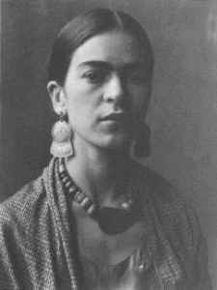
Frida's parents were married soon after the death of Guillermo's first wife, which occurred during the birth of her second child.
Although their marriage was quite unhappy, Guillermo and Matilde had four daughters, with Frida being the third.
She had two older half sisters who were raised in the same household.
Frida remarked that she grew up in a world surrounded by females.
However, during most of her life, Frida remained amicable with her father.

Slide 10
The Mexican Revolution began during 1910, when Kahlo was three years old.
Kahlo contracted polio at age six, which left her right leg thinner than the left, which she disguised by wearing long, colorful skirts.

Slide 11
In 1922, Kahlo was enrolled in the Preparatoria, one of Mexico's premier schools, where she was one of only thirty-five girls.
On September 17, 1925, Kahlo was riding in a bus that collided with a trolley car.
She suffered serious injuries as a result of the accident, including a broken spinal column, a broken collarbone, broken ribs, a broken pelvis, eleven fractures in her right leg, a crushed and dislocated right foot, and a dislocated shoulder.

Slide 12
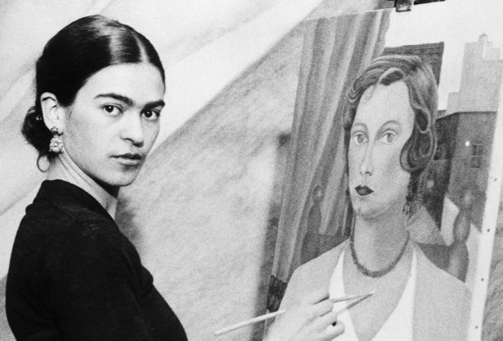
Considered one of Mexico’s greatest artists, Frida Kahlo began painting after she was severely injured in a bus accident.

Slide 13
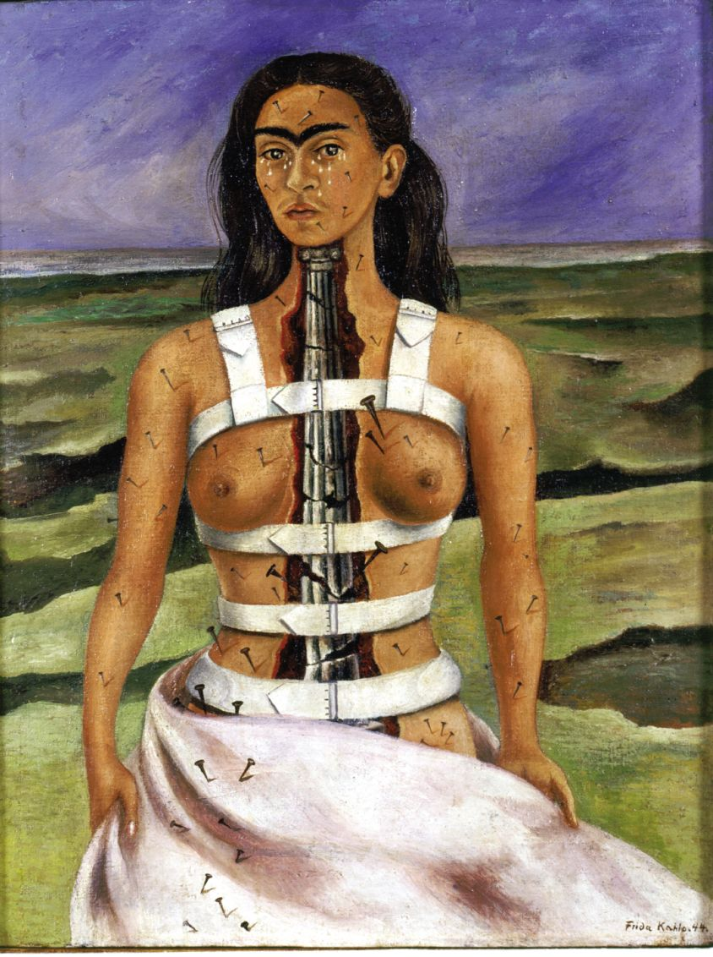
After the accident, Kahlo neglected the study of medicine to begin a painting career.

Slide 14
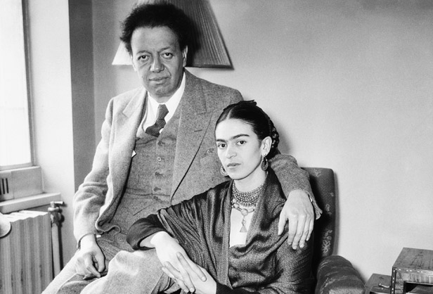
While enrolled in a premedical program at the Escuela Nacional Preparatoria in Mexico City, Frida met her future husband, famed mural painter Diego Rivera.

Slide 15
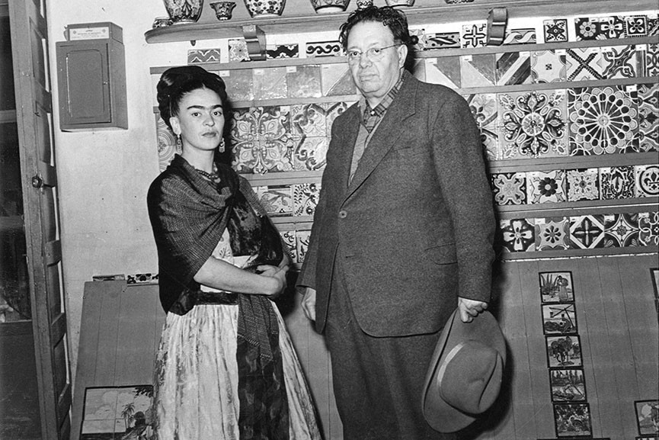
The love story of Frida Kahlo and Diego Rivera was without a doubt one of the greatest, leaving a deep mark on the 20th century art world.

Slide 16
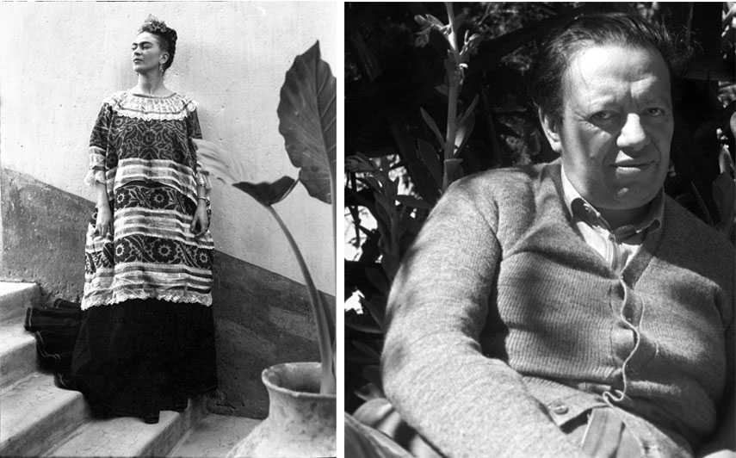
Foto: Frida y Diego. Leo Matiz © Alejandra Matiz

Slide 17
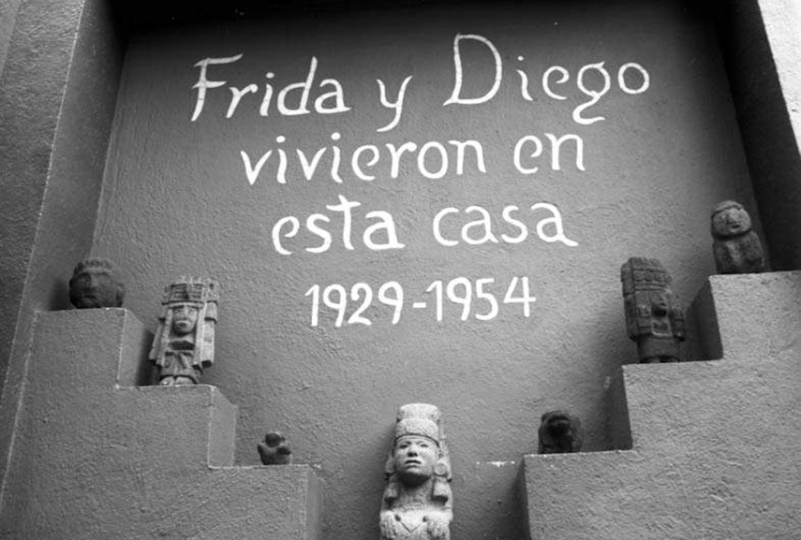
Frida y Diego. Leo Matiz © Alejandra Matiz

Slide 18
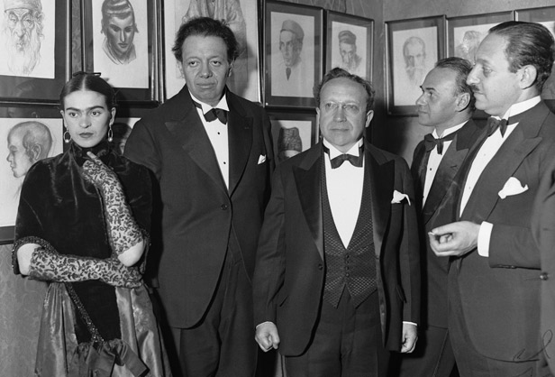
At a dinner of the Menorah Artists and Writers’ Committee in New York attended by Frida Kahlo and Diego Rivera, Rivera expressed outrage at being barred from completing a mural at Rockefeller Center because he included the image of communist leader Lenin in the painting.

Slide 19
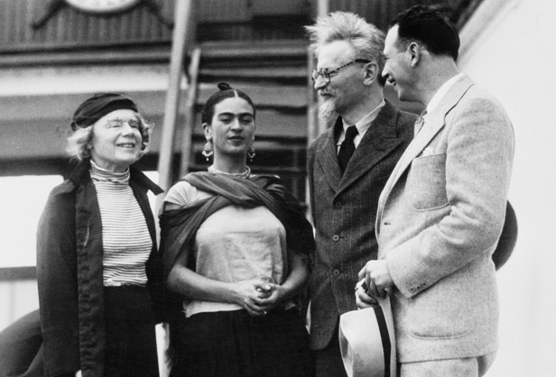
Frida Kahlo greets Leon Trotsky and his wife Ruth and provides safe harbor for the exiled communist leader at her "blue house" in Mexico.

Slide 20
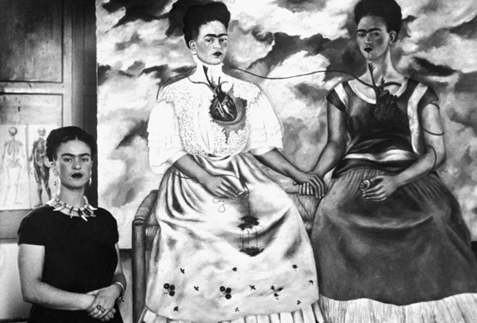
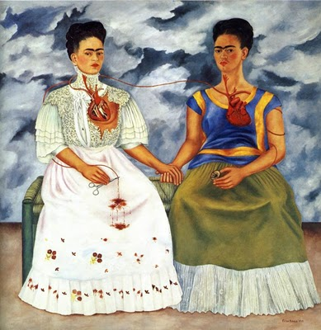
"The Two Fridas"
Many of Frida Kahlo’s self-portraits are expressions of the duality she felt at having both European and Mexican heritage, as shown in this 1939 painting entitled
"The Two Fridas"

Slide 21
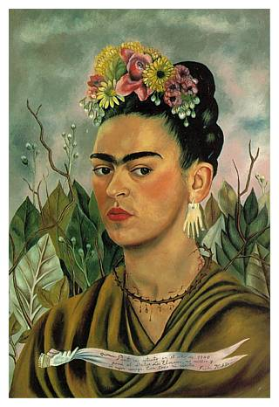
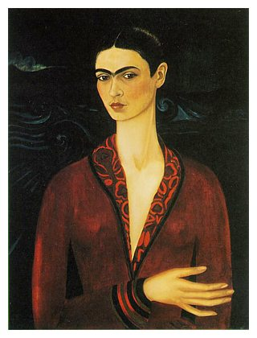
Self Portrait
(oil on board, 1940)
Self-Portrait in a Velvet Dress
(oil on canvas, 1926)

Slide 22
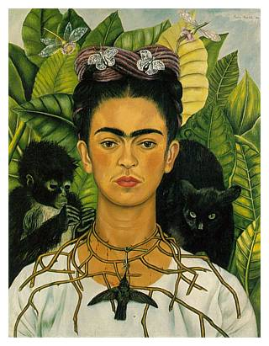
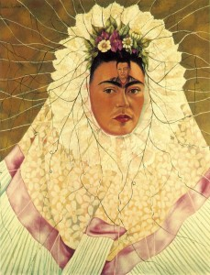
Self Portrait as a Tehuana Diego in My Thoughts 1943

Slide 23
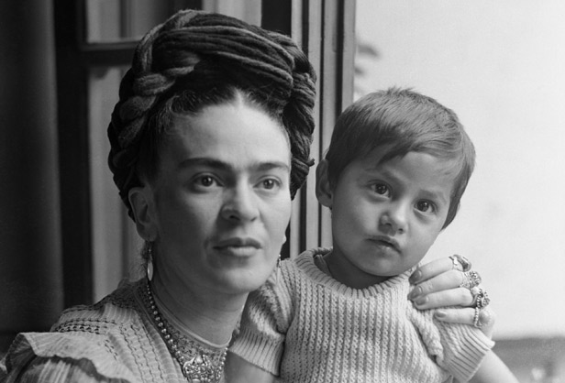
Although Kahlo tried several times to have a child, complications from a bus accident when she was 18 made it impossible for her to carry a pregnancy to term.

Slide 24
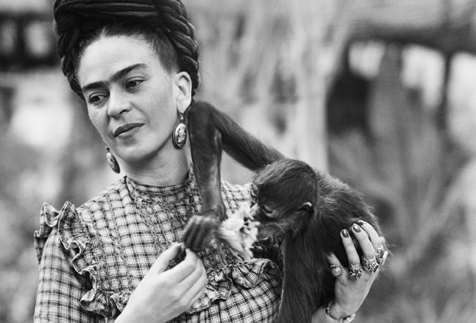
The traditional Mexican style of hair and dress of braids and long peasant skirts was Frida Kahlo's signature look.

Slide 25
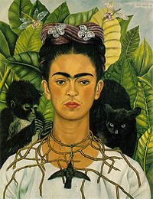
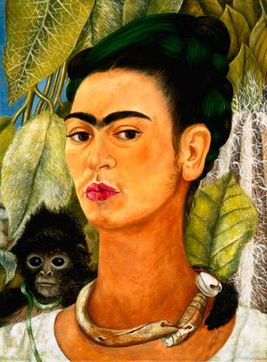
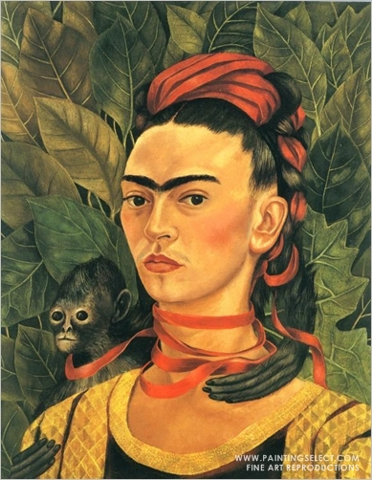
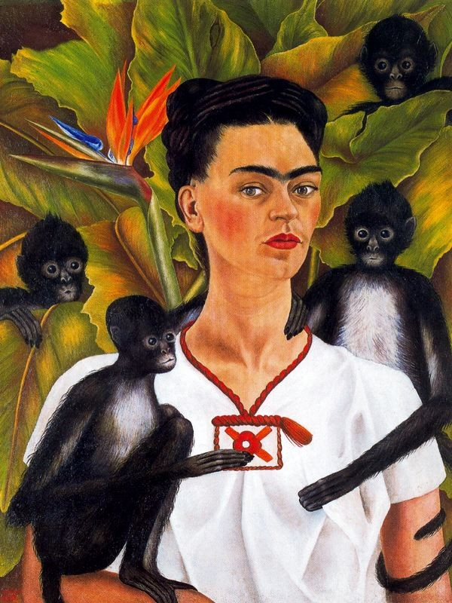
Frida Kahlo often included monkeys in her paintings, as in this 1938 self-portrait, portraying them as friendly protective pets rather than symbols of lust as believed in Mexican folklore.
Self-portrait with Thorn Necklace
and Hummingbird
“self-portrait whith monkeys”

Slide 26
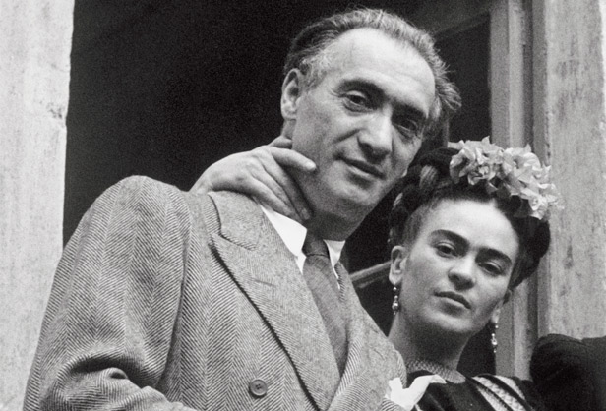
Frida Kahlo and Hungarian-born photographer Nickolas Muray had an affair during the 1930's His 1938 portrait of Kahlo became one of his most famous works.

Slide 27
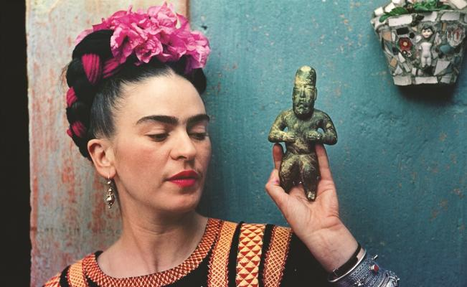
Foto: Leo Matiz

Slide 28
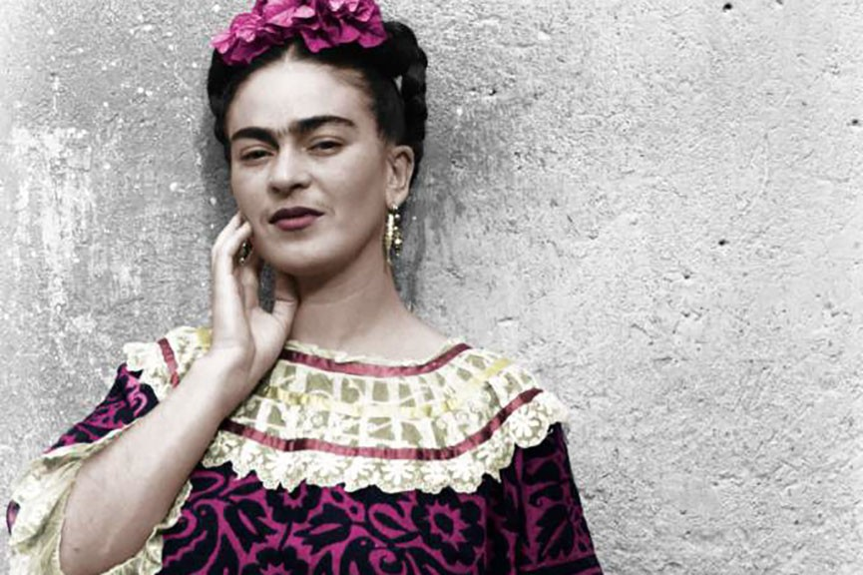
Frida Kahlo died on July 13, 1954, soon after turning 47.
A few days before her death she wrote in her diary:

Slide 29
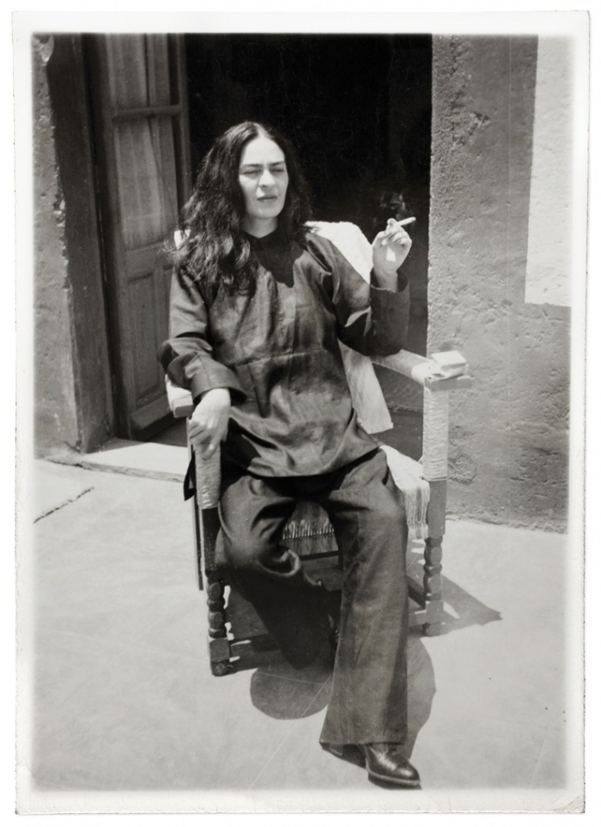
"I hope the exit is joyful and I hope never to return”
Frida Kahlo

Slide 30
Fuentes
http://www.eluniversal.com.mx/articulo/cultura/artes-visuales/2016/09/16/fotos-de-leo-matiz-muestran-en-madrid-intimidad-de-frida
http://dejenmevivir.wordpress.com/2011/01/21/frida-kahlo-_-%E2%80%9Cyo-sufri-dos-accidentes-graves-en-mi-vida%E2%80%A6-el-otro-accidente-es-diego%E2%80%9D/
http://www.widewalls.ch/frida-kahlo-diego-rivera-leo-matiz/
https://icm.sre.gob.mx/espana/index.php/eventos/artes-visuales/301-frida-khalo-fotografias-de-leo-matiz-en-la-casa-azul
http://www.elmercuriodigital.net/2016/03/exposicion-frida-kahlo-fotografias-de.html#.WNsXJfk1_IU

Slide 31
Gracias por su atención
¿Preguntas?
Mtra. Ma. Del Rosario Cortés Nájera
Correo electrónico: rosariocn7@yahoo.com.mx

