Slide 1

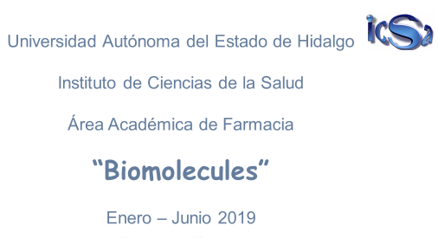
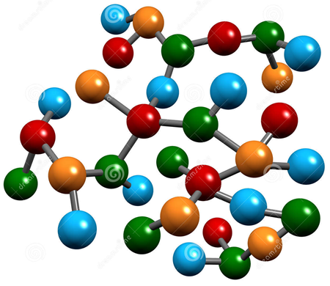
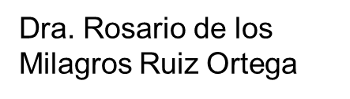
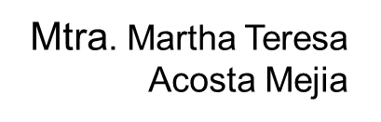

Slide 2

Biomolecules Abstract
Biochemistry is the chemistry of life, which means that studies the molecules that allow life: biomolecules. There are two types of biomolecules, inorganic such as water and carbon dioxide, and organic which are so big that are called macromolecules. There are four macromolecules: carbohydrates, proteins, nucleic acids and lipids. All of them have specific structures and functions, so important that without them life would not be possible.
Key words: biomolecule, organic, inorganic, structure, function

Slide 3
Biomolecules Objective
Examine the major groups of molecules that make up living organisms along with some of the properties and functions of these molecules, and distinguish between organic and inorganic molecules.

Slide 4
Biomolecules Diagnostic test
https://docs.google.com/forms/d/e/1FAIpQLSdk-d8oPp2zVujMG5mCqnycpdlRE-mahXL5svz_PzVkJpERaw/viewform?usp=sf_link

Slide 5
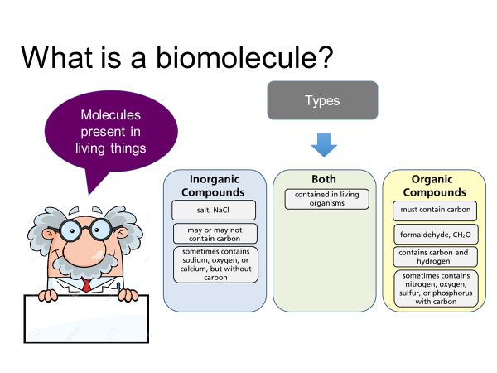

Slide 6
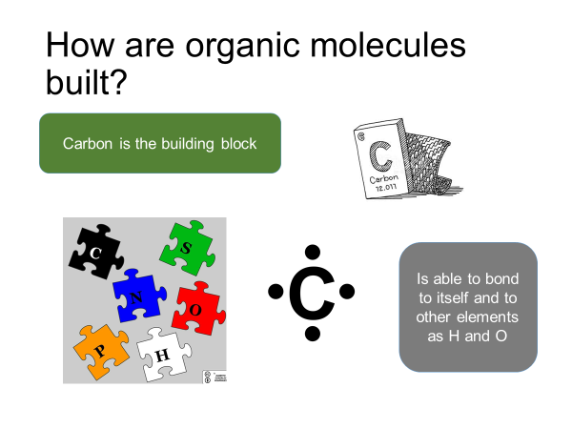

Slide 7
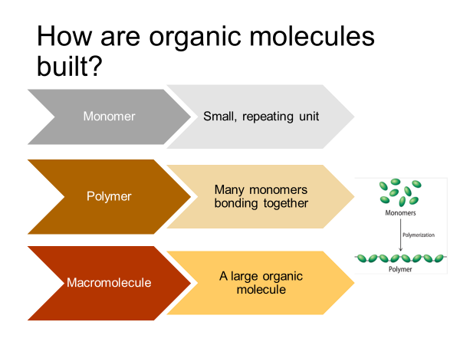

Slide 8
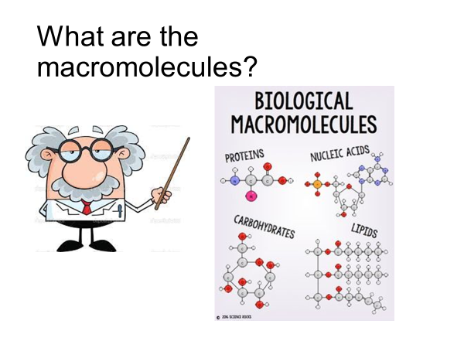

Slide 9
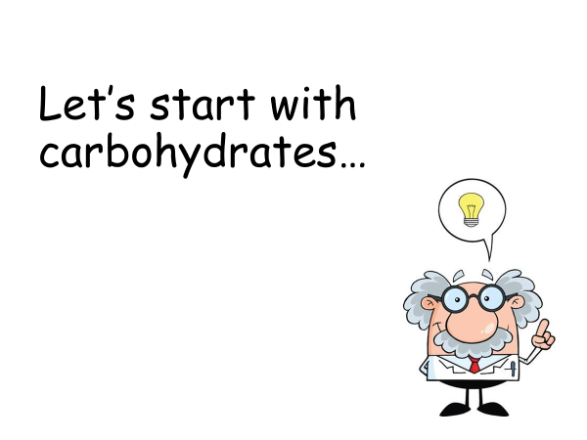

Slide 10
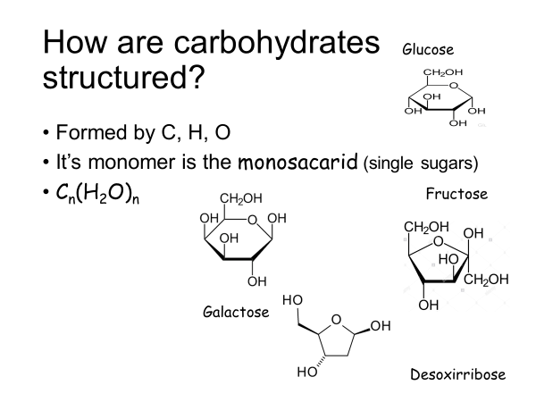

Slide 11
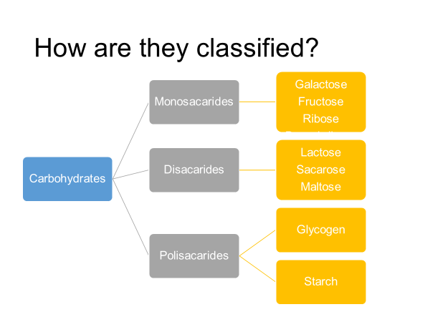

Slide 12
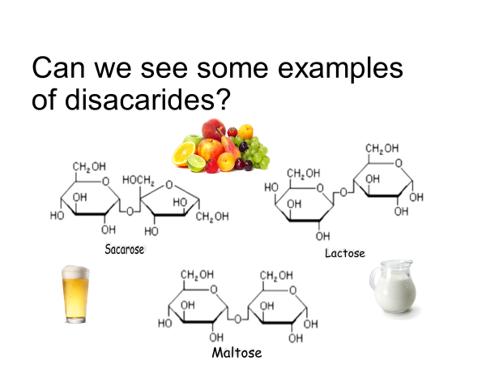

Slide 13
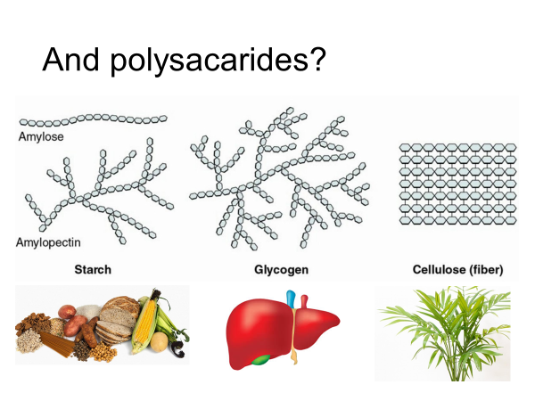

Slide 14
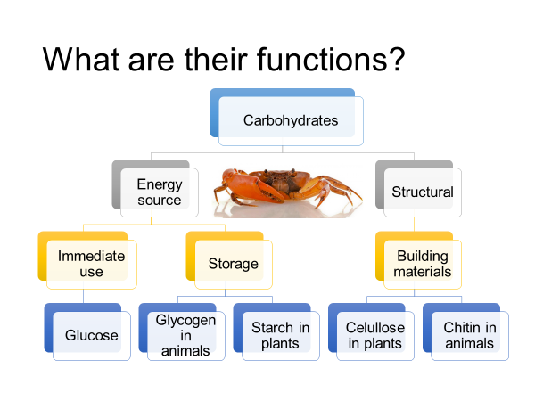

Slide 15
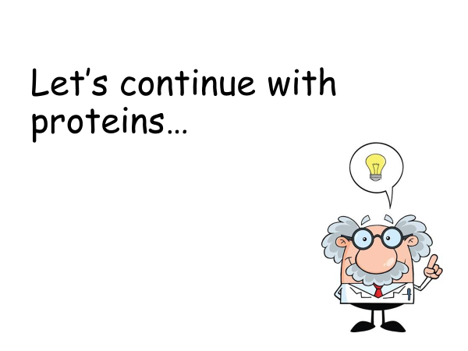

Slide 16
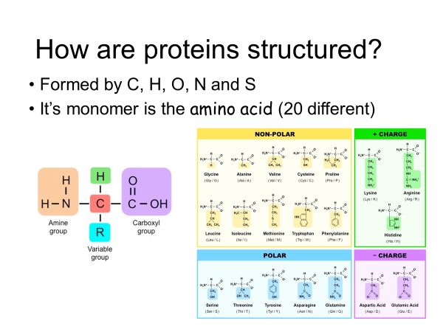

Slide 17
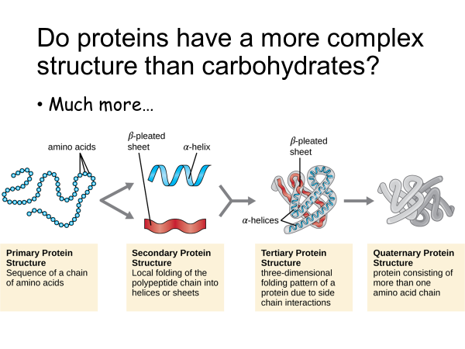

Slide 18
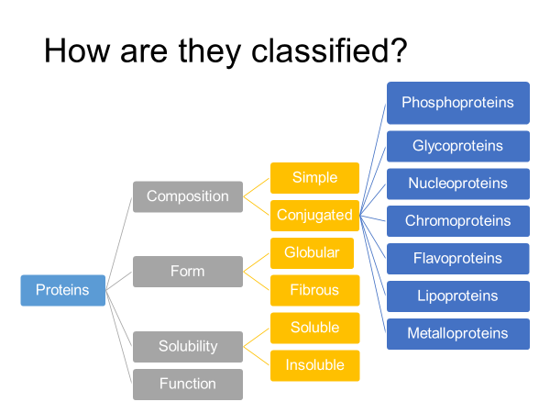

Slide 19
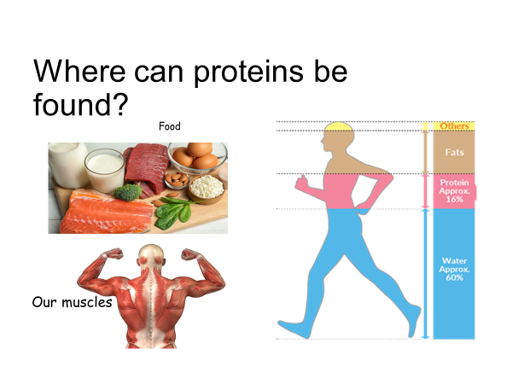

Slide 20
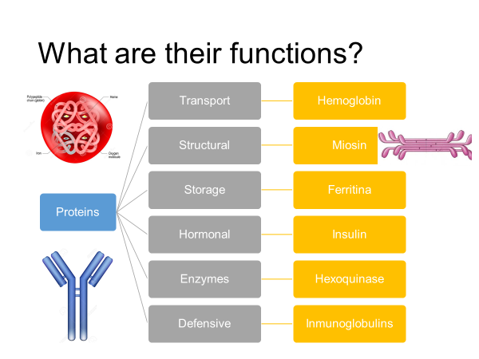

Slide 21
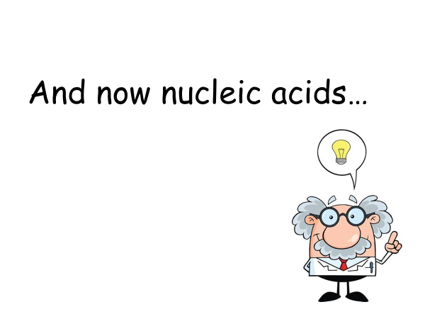

Slide 22
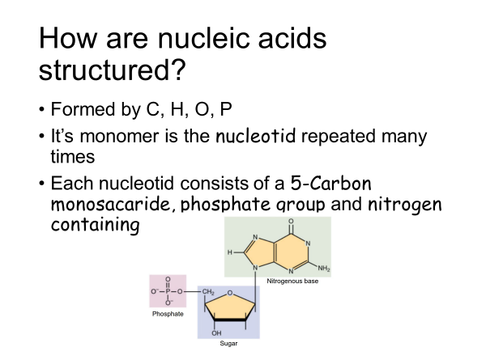

Slide 23
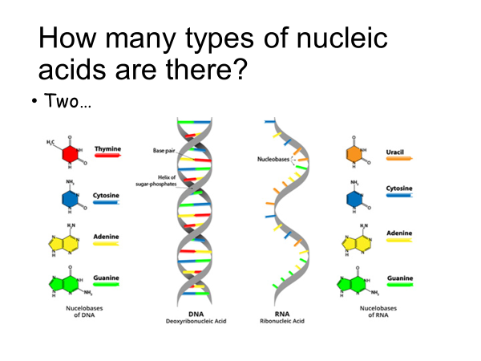

Slide 24
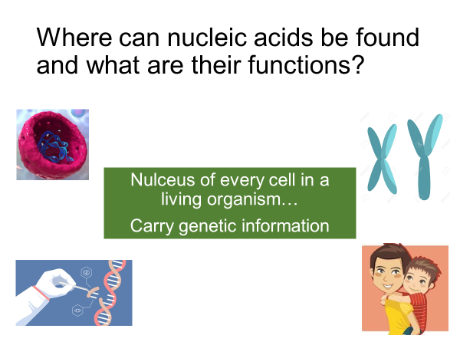

Slide 25
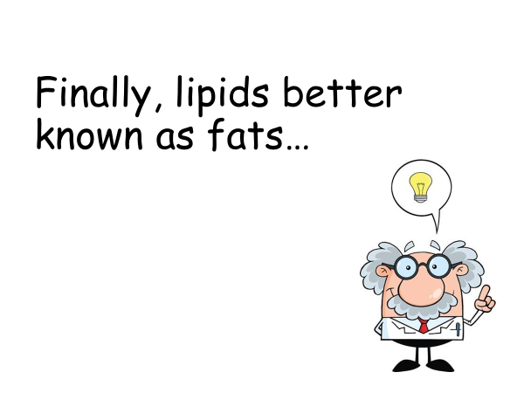

Slide 26
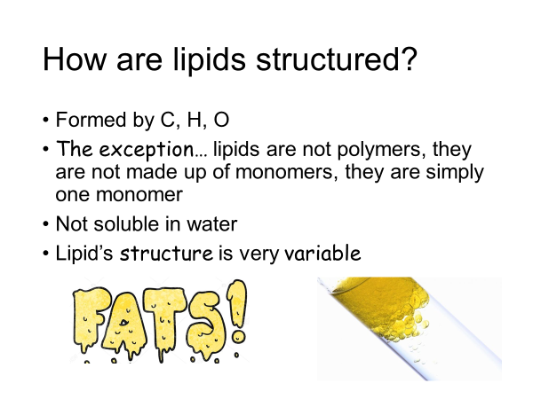

Slide 27


Slide 28
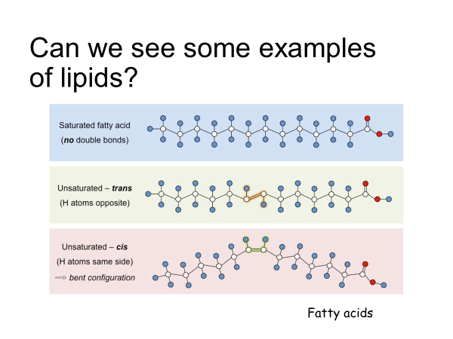

Slide 29
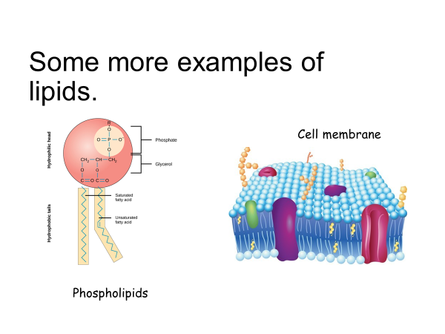

Slide 30
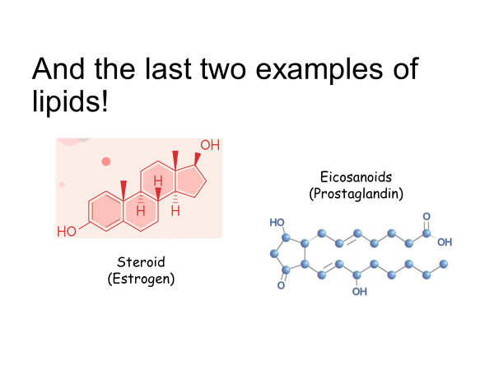

Slide 31
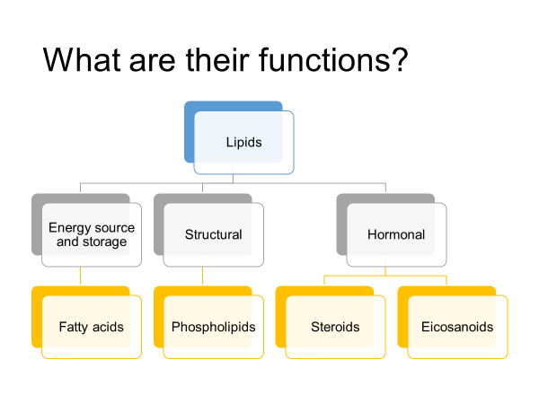

Slide 32

A video to reinforced knowledge… Retrieved from: https://youtu.be/f84c4VCOo4s

Slide 33
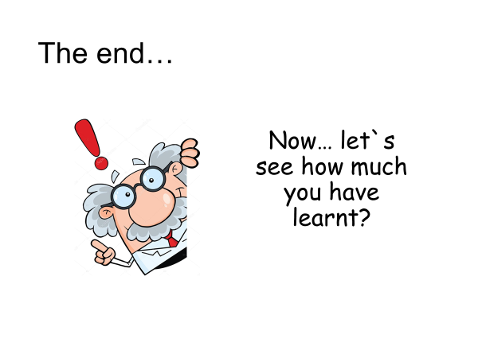

Slide 34
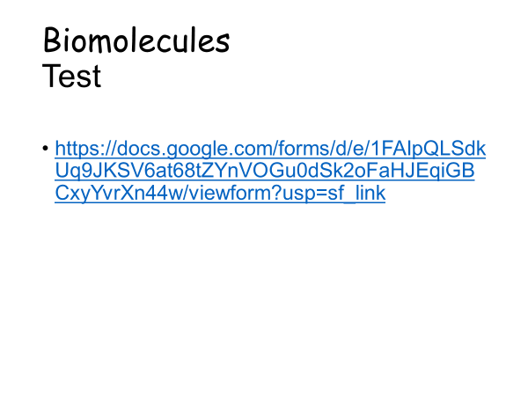

Slide 35
