Slide 1

INGLÉS III
UNIT 1. THE ARTS
TOPIC: TALKING ABOUT ARTS
TEACHER: MTE. HEIDI ZAMORA NAVA
JULY – NOVEMBER, 2015

Slide 2
Abstract:
To be able to talk about any kind of topics in our lives let us to increase our cultural background and grow as human beings, for that reason our English program takes into account topics related to arts, tourism, politics, among others.
Key words: arts vocabulary, painters, paintings, art work.

Slide 3
Competence no. 4.
I express and communicate.
This material was created to give a review about the use of adjectives for describing arts works and giving points of view.

Slide 4
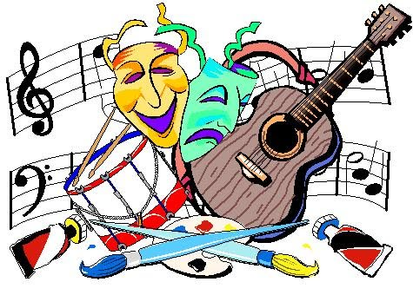

Do you like arts?

Slide 5
What kind of art do you like?
Painting
Sculpture
Architecture
Music
Dance
Novels
Poetry
Theater
Cinema

Slide 6
Useful phrases:
My favorite Art work of art is:
__________________________________
I love ________________
I don’t like _____________
In my opinion ___________________

Slide 7
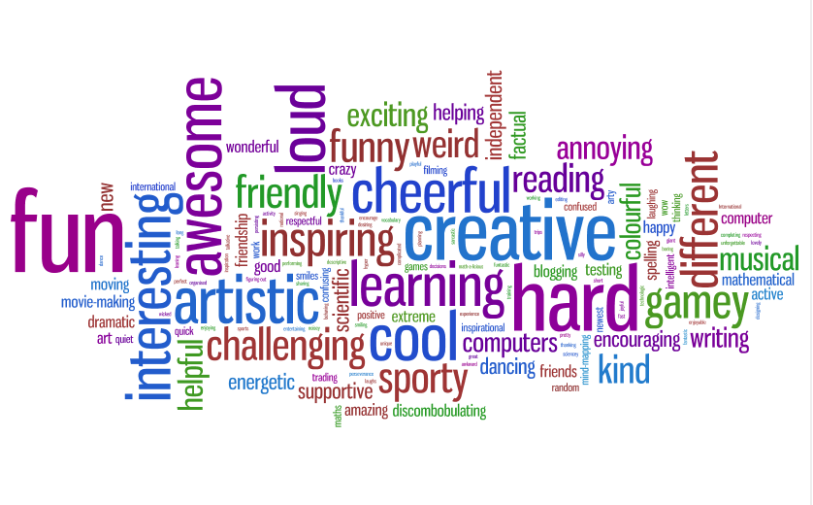
Adjectives

Slide 8

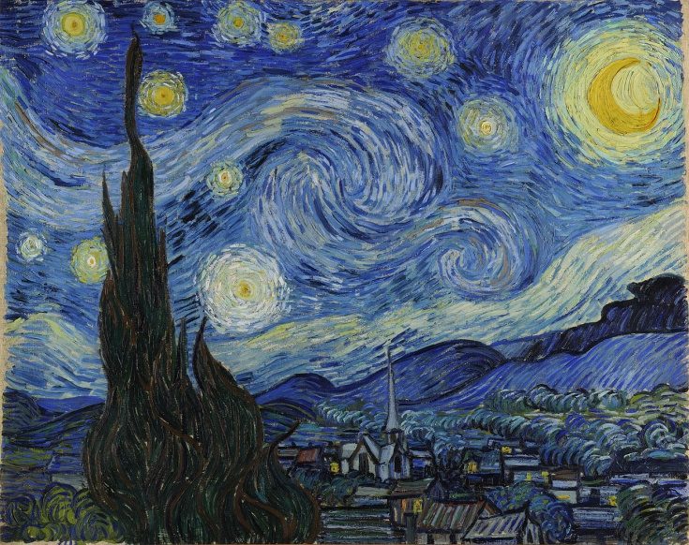
PAINTING
My favorite art work of art is a Van Gogh’s painting.
It is called “Stary Night”
I love this painting.
In my opinion it is a realistic painting.

Slide 9
Now, it is your turn!!

Slide 10
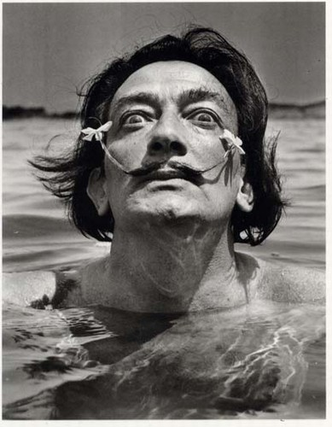
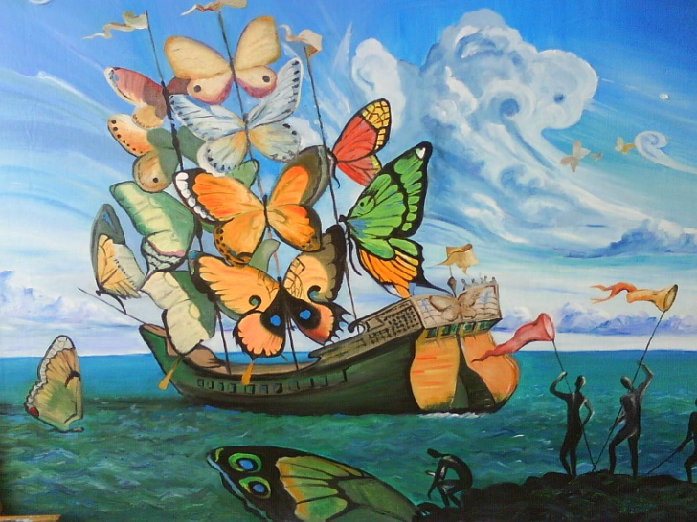
What’s your opinion about Salvador Dalí and his work?
I don’t like Dali’s paintings, because they are…..
weird
ugly
mysterious

Slide 11
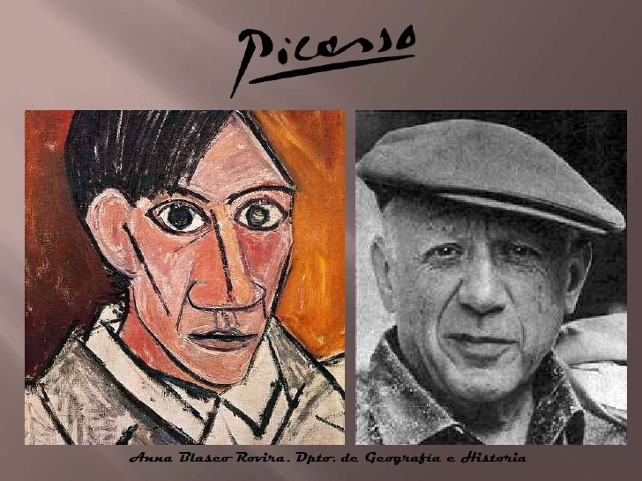
What is your opinion about Pablo Picasso and his work?

Slide 12
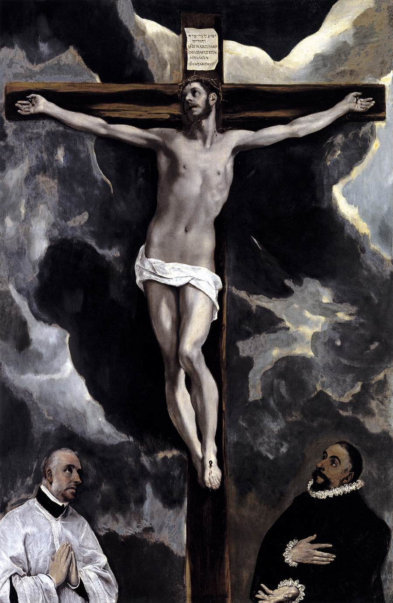
What’s your opinion about El Greco and his work?

Slide 13
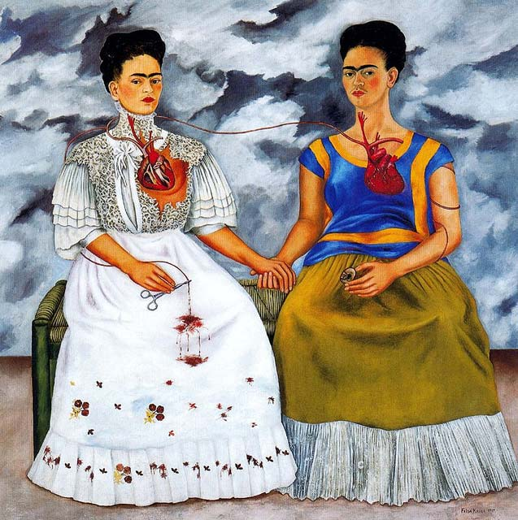
What’s your opinion about Frida Kahlo and her work?

Slide 14
Sources:
Book Make it Real!!! UAEH – 2015
Images:
https://www.google.com.mx/search?q=like,+don%27t+like+icons&rlz=1C1ASAC_enMX456MX456&es_sm=93&biw=1280&bih=675&source=lnms&tbm=isch&sa=X&ved=0CAYQ_AUoAWoVChMImIv8lbrPyAIVjI4NCh350AYA#tbm=isch&q=adjectives+for+describing+arts&imgrc=UdCEmvcsDtMttM%3A
https://www.google.com.mx/search?q=like,+don%27t+like+icons&rlz=1C1ASAC_enMX456MX456&es_sm=93&biw=1280&bih=675&source=lnms&tbm=isch&sa=X&ved=0CAYQ_AUoAWoVChMImIv8lbrPyAIVjI4NCh350AYA#tbm=isch&q=kahlo&imgrc=54ld3FH58dcbeM%3A
https://www.google.com.mx/search?q=like,+don%27t+like+icons&rlz=1C1ASAC_enMX456MX456&es_sm=93&biw=1280&bih=675&source=lnms&tbm=isch&sa=X&ved=0CAYQ_AUoAWoVChMImIv8lbrPyAIVjI4NCh350AYA#tbm=isch&q=kahlo&imgrc=54ld3FH58dcbeM%3A

