Slide 1
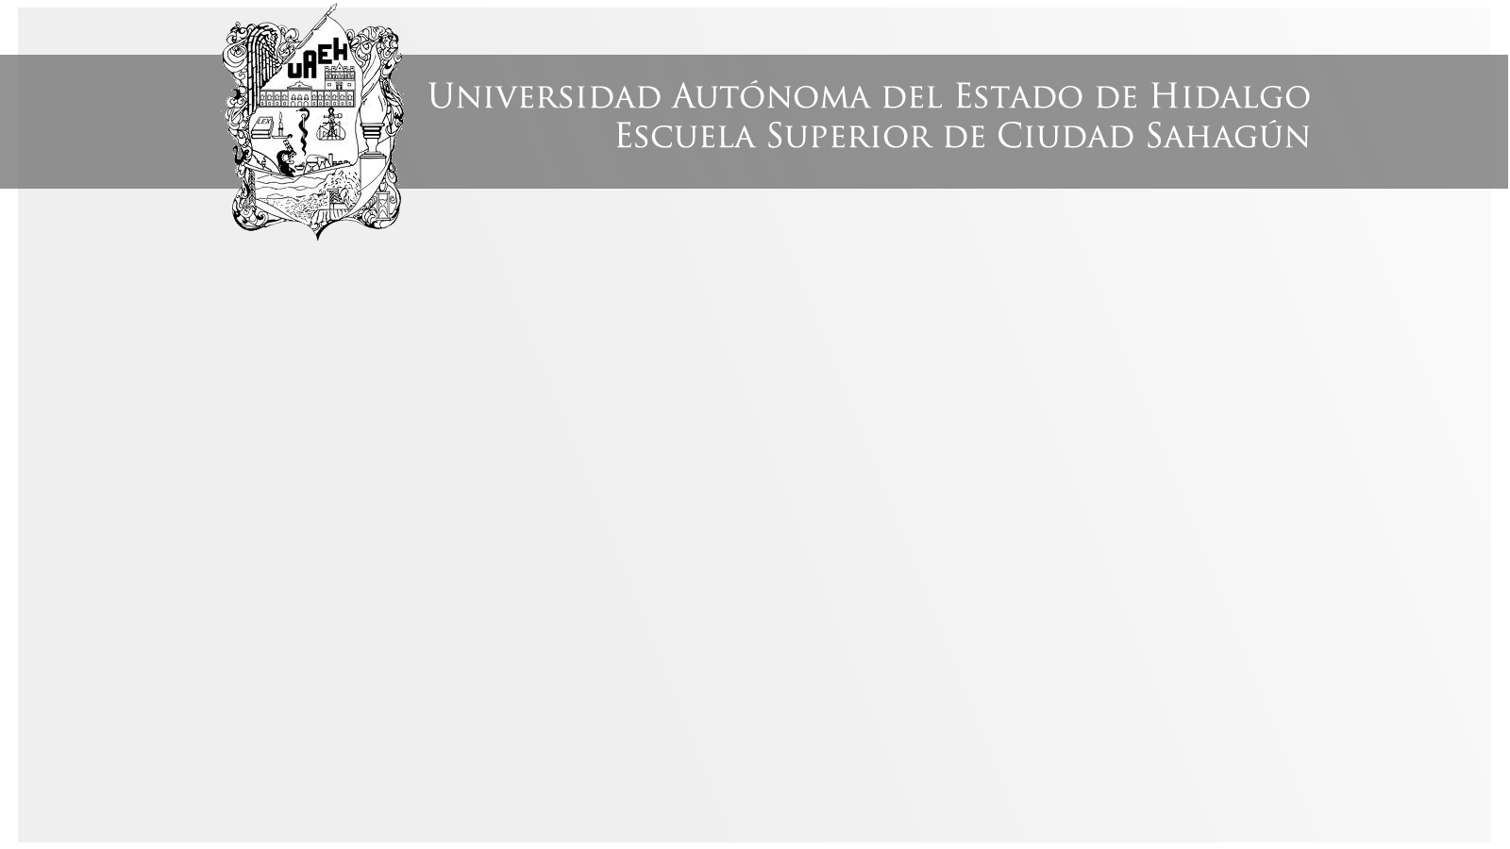
VERB TO BE
Área Académica: Ingeniería Mecánica
Profesor(a): Ma. E. Guadalupe Islas López
Periodo: ENERO_JUNIO 2017

Slide 2

VERB TO BE
Resumen
El verbo “to be” es el primer tema de la unidad I que conforma el PAI (programa académico institucional) de la materia de conversaciones introductorias en lengua extranjera.
Abstract
The verb “to be” is the first topic in unit I in PAI (programa académico institucional) in the subject introductory conversations in a foreign language.
Keywords: verbo to be,unidad I, conversaciones, lengua extranjera

Slide 3
Desarrollo del tema
Affirmative |  | Interrogative
Long form | Short form
I am | I’m | Am I?
You are | You’re | Are you?
He is | He’s | Is he?
She is | She’s | Is she?
It is | It’s | Is it?
We are | We’re | Are we?
You are | You’re | Are you?
They are | They’re | Are they?

Slide 4
Desarrollo del tema
Short answers
Are answers to questions which begin with the verb form is/are. In short answers we do not repeat the whole question. We only use yes or no, the subject pronoun (I, you, he, etc) and the verb form is (isn’t)/are (aren’t).

Slide 5
Are you English?
Yes, I am/we are
No, I’m not/ we aren’t
Is he/she/it French?
Yes, he/she/it French
No, he/she/it is
Are they Chinese?
Yes, They are
No, they aren’t

Slide 6
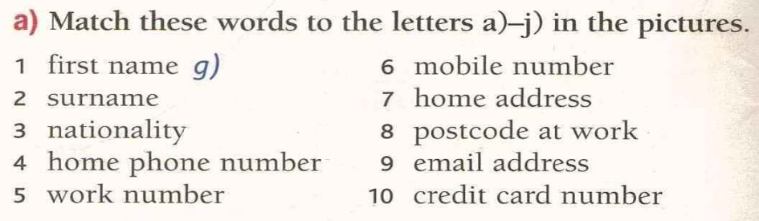
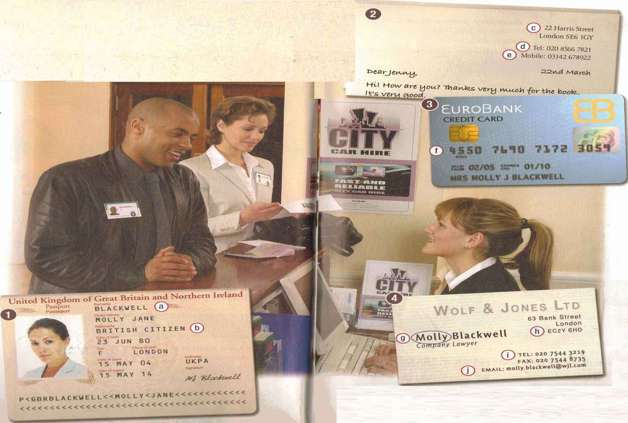
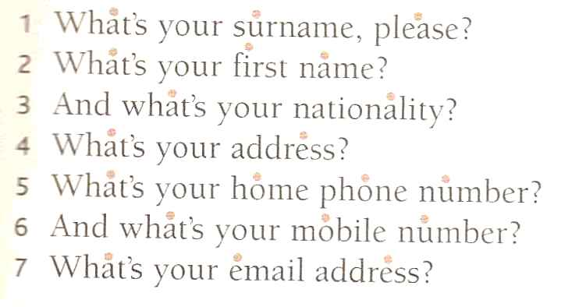

Slide 7
WHAT IS YOUR JOB/PROFESSION?
HOW OLD ARE YOU?
ARE YOU MARRIED OR SINGLE?
DO YOU HAVE CHILDREN?
WHAT IS YOUR HOBBY?
WHAT ARE YOUR HOBBIES?

Slide 8
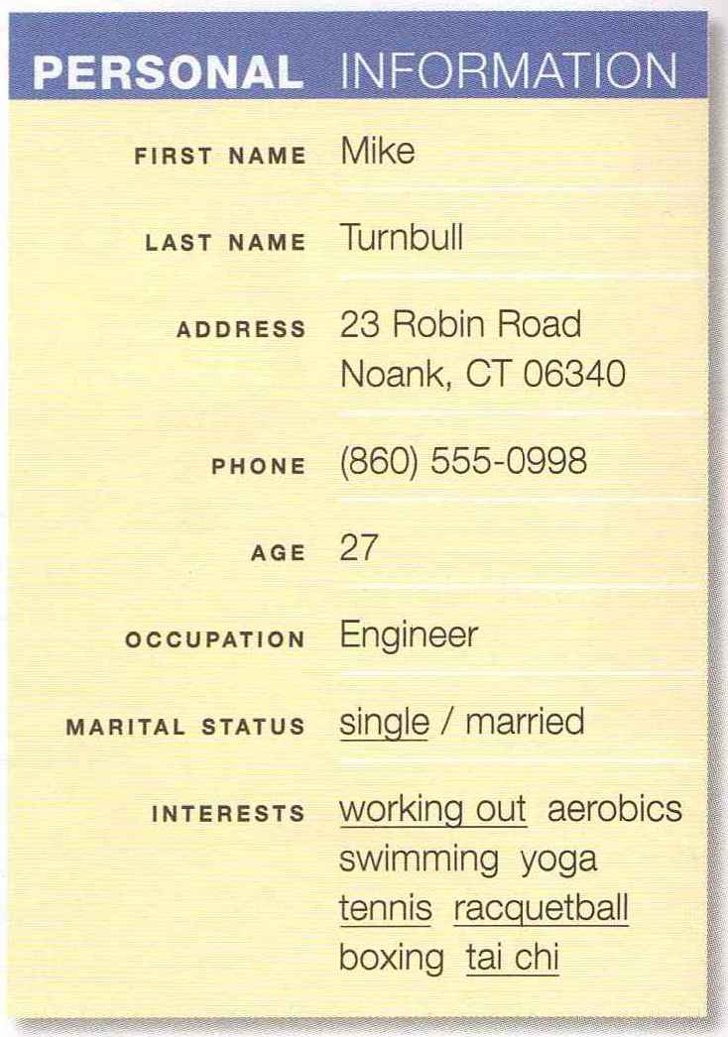
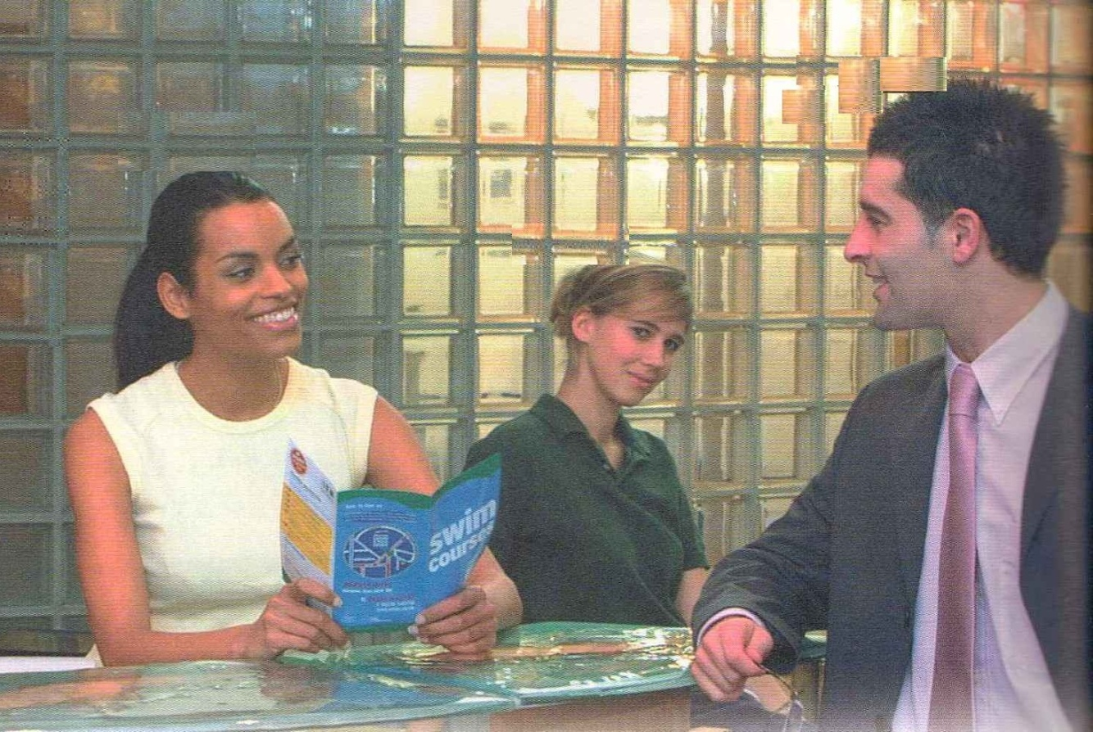

Slide 9
Referencias
Evans, V. y Dooley, J. (2003). Upstream. Beginner. Express Publishing.

