Slide 1
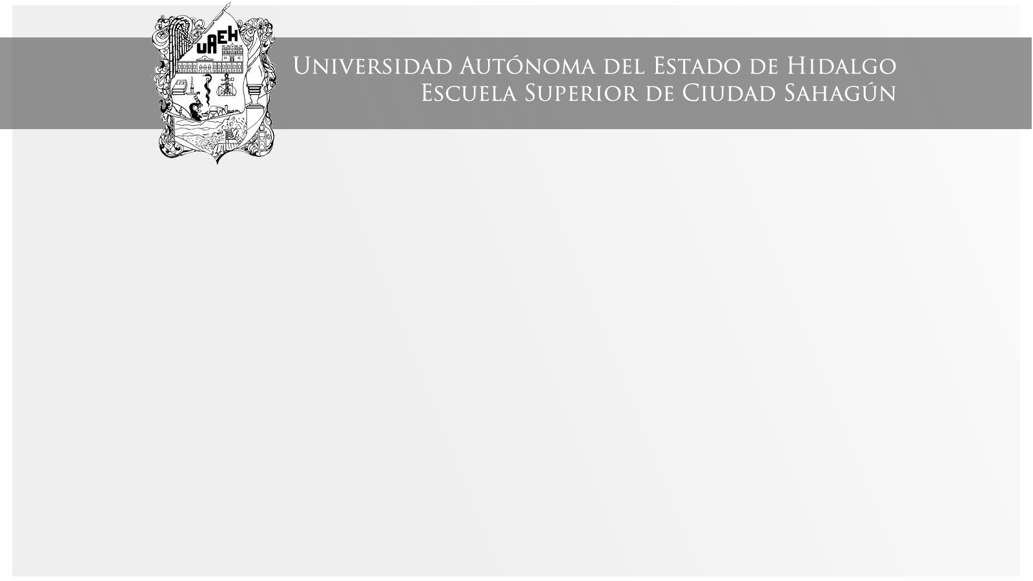
PRESENTE PERFECTO
Área Académica: Ingeniería Mecánica
Profesor(a): Ma. E. Guadalupe Islas López
Periodo: ENERO_JUNIO 2017

Slide 2

PRESENTE PERFECTO
Resumen
El presente perfecto, el tiempo más confuso en inglés, lo usamos para acciones pasadas.
Abstract
The present perfect is for past accions that start in the past but still continue.
Keywords: past accions, continue.

Slide 3
1. The men paint the house. Present Simple
2. The men painted the house. Past simple
3. The men have painted the house. Present Perfect

Slide 4
Personal pronoun +“ have /has” + past participle form of verb
Present eat write | Past ate wrote | Present participle eating writing | Past Participle eaten Written
I have eaten a sandwich

Slide 5
PRESENT PERFECT -used to describe an action that has been completed.
Isn’t the Past Tense also used to describe completed action?
“Ali went to school.”

Slide 7
What do you need the Present Perfect for ?
to tell what you have done recently/ lately.
to tell what you have just or already done.
to tell what you have never/ ever done.
to tell what you have done so far/ up to now.
to tell what you have done today/ this week/ this month/ this year.

Slide 8
Referencias
Evans, V. y Dooley, J. (2003). Upstream. Elementary. Express Publishing.

