Slide 1
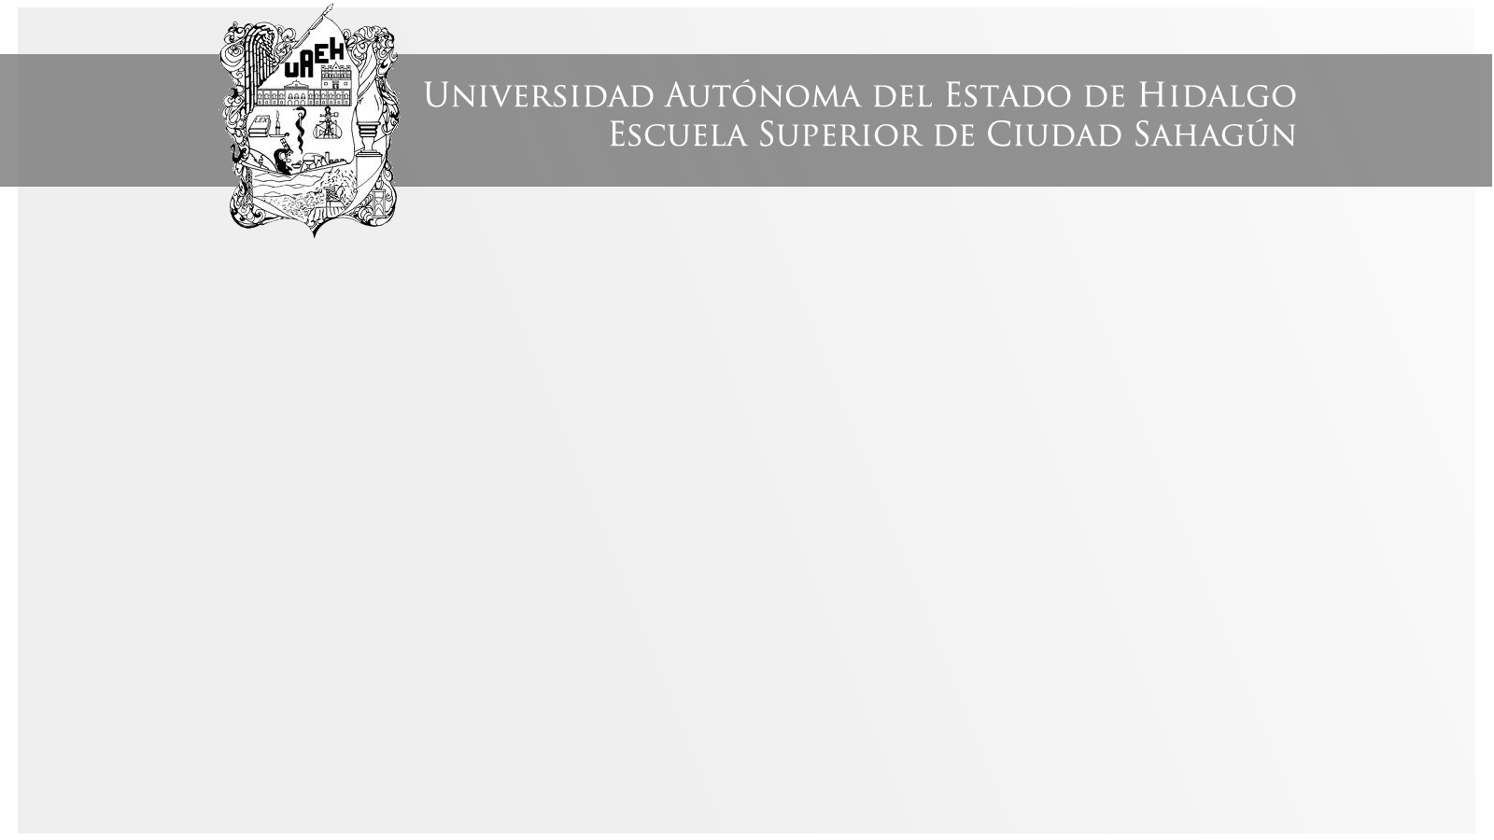
PAST SIMPLE TENSE
Área Académica: Ingeniería Mecánica
Profesor(a): Ma. E. Guadalupe Islas López
Periodo: ENERO_JUNIO 2017

Slide 2

PAST SIMPLE TENSE
Resumen
El tiempo pasado simple es el primer tema de la unidad I que conforma el PAI (programa académico institucional) de la materia de eventos pasados y futuros en lengua extranjera.
Abstract
The past simple tense is the first topic in unit I in PAI (programa académico institucional) in the subject past and future events in a foreign language.
Keywords: past, unidad I, eventos, lengua extranjera

Slide 3
Regular verbs form
-ed for all persons
Play → played
Work → worked
Stay → stayed
Listen → listened

Slide 4
SPELLING:
1) Double the consonant if the consonant is stressed stop – stopped swap - swapped
2)Add only –d, when the verb ends with –e
love – loved save – saved
3)Verbs ending in 'y' preceded by a consonant:
Change 'y' to 'i' Then add -ed.
hurry - he hurried (watch out! play – played)

Slide 5
Irregular verbs form
The form CHANGES from infinitives, usually with a vowel change.
Can be grouped according to certain change patterns, which helps to memorize them.

Slide 6
Certain change patterns
speak → spoke
eat → ate
see → saw
fly → flew
think → thought

Slide 7
Verb TO BE
I
he
she
it
you
we
they
were
was

Slide 8
Past Simple Use
Actions that started and finished in the past
I went to the beach last Sunday
I bought a new car yesterday.

Slide 9
Past Simple Use
Actions that happened one after the in the past (like in a story)
He came in, took off his coat and sat down.
I went into the disco and I saw my favourite girl, then I asked her to dance,...
.

Slide 10
Negative Sentences
DID NOT + VERB (base form)
Example: I did not work yesterday
or
I didn’t work yesterday
INCORRECT: I didn’t worked

Slide 11
Negative Sentences verb TO BE
WAS / WERE + NOT
Examples:
I was not at school yesterday afternoon
or
I wasn’t at school yesterday afternoon
They were not at home last weekend
or
They weren’t at home last weekend

Slide 12
REMEMBER!!
Positive sentences:
I played football yesterday
I went home early on Saturday
Negative sentences:
I didn’t play football yesterday
I didn’t go home early on Saturday
Yes/No questions:
Did you play football yesterday?
Did you go home early in Saturday?

Slide 13
Positive sentences:
I was in London last year
Negative sentences:
-They weren’t at home last weekend
Yes/No questions:
Were you ill yesterday?

Slide 14
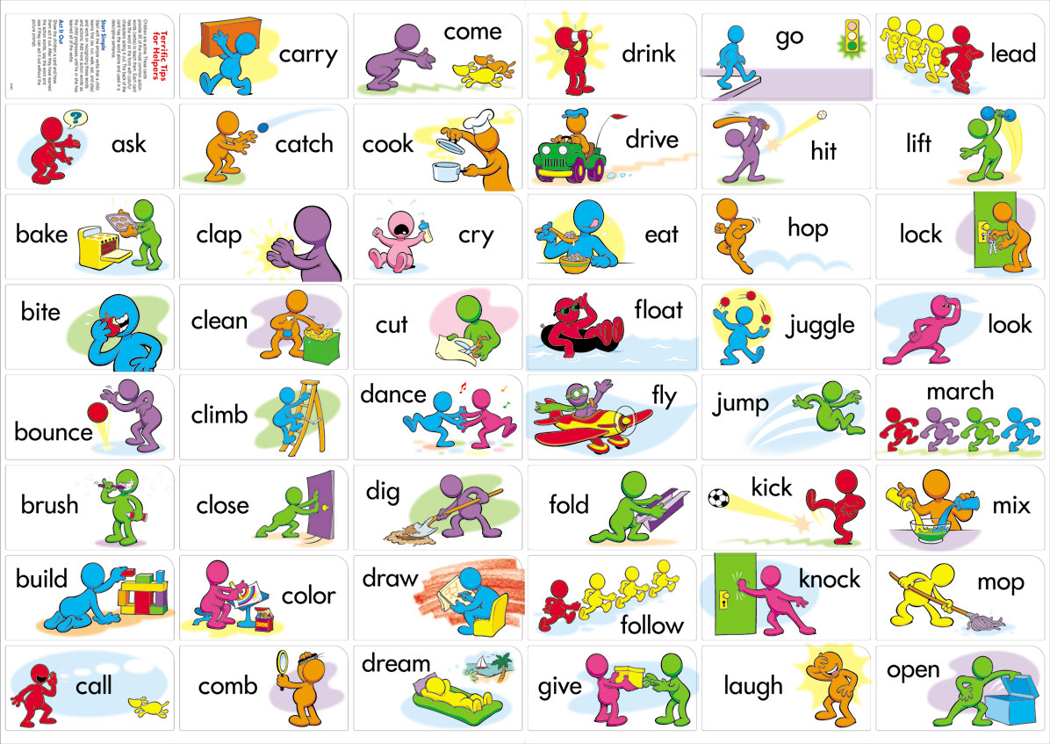

Slide 15
Referencias
Evans, V. y Dooley, J. (2003). Upstream. Beginner. Express Publishing.

