Slide 1
PAST CONTINUOUS
Área Académica: INGENIERÍA MECÁNICA
Profesor(a): MA. E. GUADALUPE ISLAS LÓPEZ
Periodo: ENERO_JUNIO 2017

Slide 2

PAST CONTINUOUS
Resumen
El tiempo pasado continuo es el primer tema de la unidad II que conforma el PAI (programa académico institucional) de la materia de Eventos pasados y futuros en lengua extranjera.
Abstract
The past simple continuous is the first topic in unit II in PAI (programa académico institucional) in the subject past and Future events in a foreign language.
Keywords: past, unidad II, eventos, lengua extranjera

Slide 3
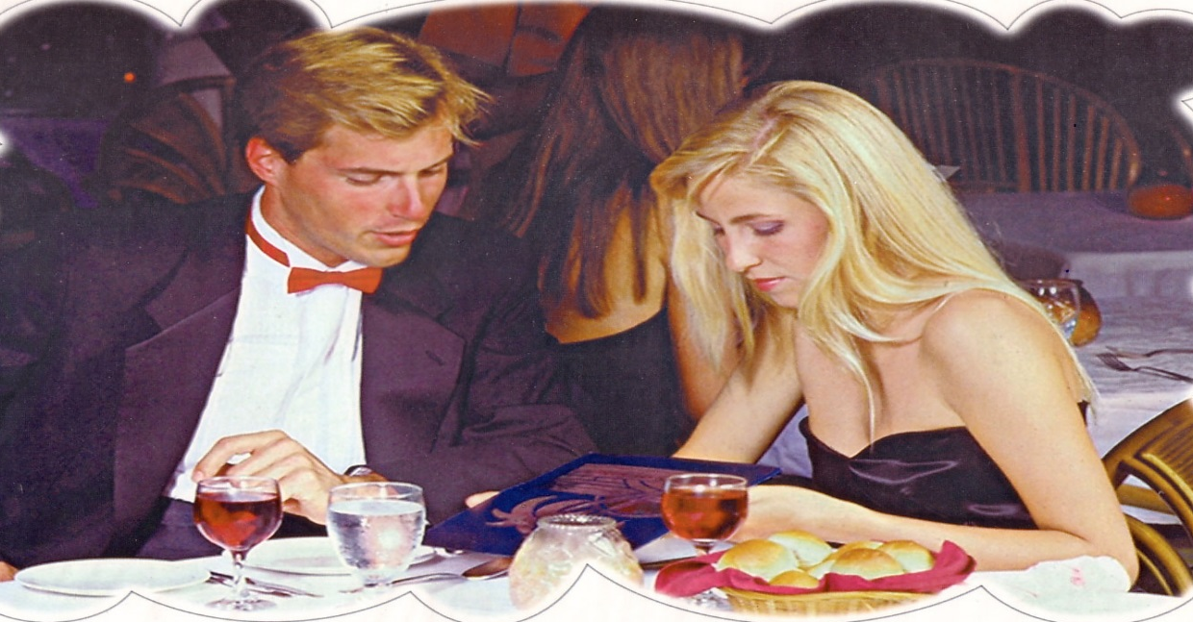
Past Continuous
Were Paul and Claire working at eight o’clock
last night?
No, they weren’t.
They were having dinner at a restaurant.

Slide 4
Form
was/were + Ving
affirmative: She was studying
interrogative: Was she studying?
negative: She wasn’t studying.

Slide 5
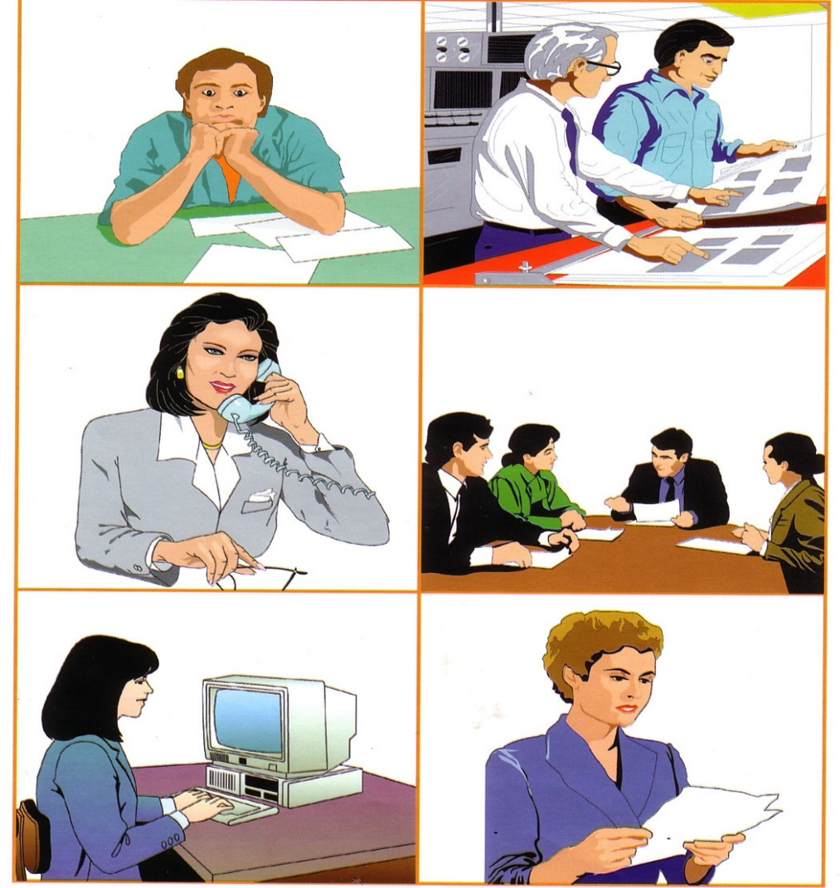
A fire broke out yesterday at Crofton Electronics. What were the people doing when the fire broke out?
Tim/sit/at his desk
Jim and Robert/check some reports
Sarah/talk/on the phone
The directors/have/a meeting
Mary/work/on the computer
Kim/read/a letter

Slide 6
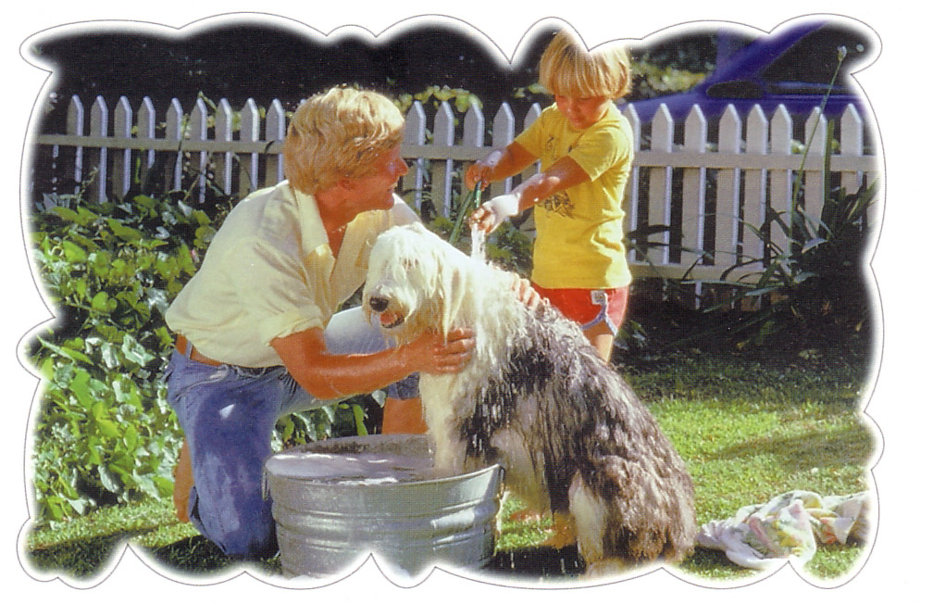
Use
At three o’clock yesterday afternoon Mike and his son were washing the dog.
Is it a long or short action?
Did they start washing the dog at three o’clock?
Did they finish washing the dog at three o’clock?
Do we know when they started or finished washing the dog?

Slide 7
Use 1
We use the Past Continuous for an action which was in progress at a stated time in the past. We do not know when the action started or finished.

Slide 8
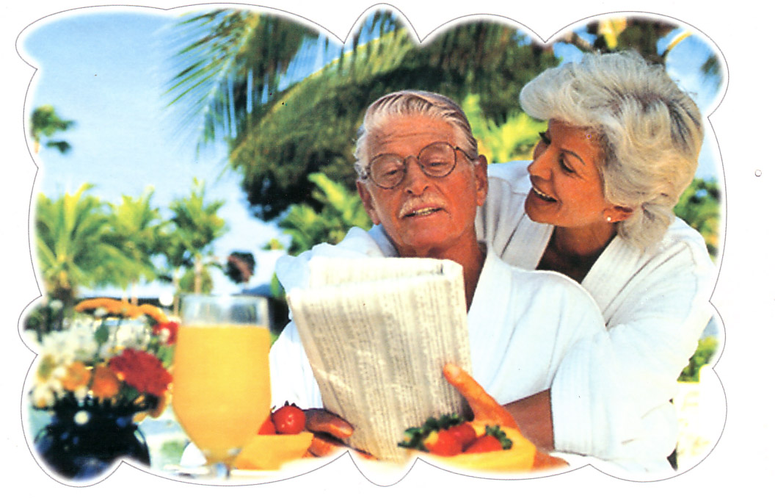
Use
He was reading a newspaper when his wife came.
How many actions are there?
Which action is the long one?
Which action is the short one?
Which action started first?
Which action interrupted the first one?

Slide 9
Use 2
We use the past continuous for a past action which was in progress when another action interrupted it. We use the past continuous for the longer action and the past simple for the shorter action.

Slide 10
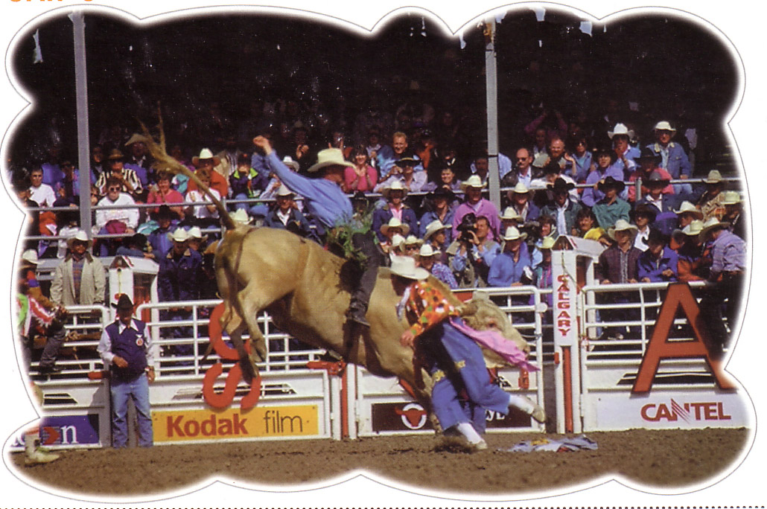
Use
The people were watching while the cowboy was riding the bull.
How many actions are there?
Did they happen at different times?
Did they happen at the same time?

Slide 11
Use 3
We use the past continuous for two or more actions which were in progress at the same time in the past (simultaneous actions).

Slide 12
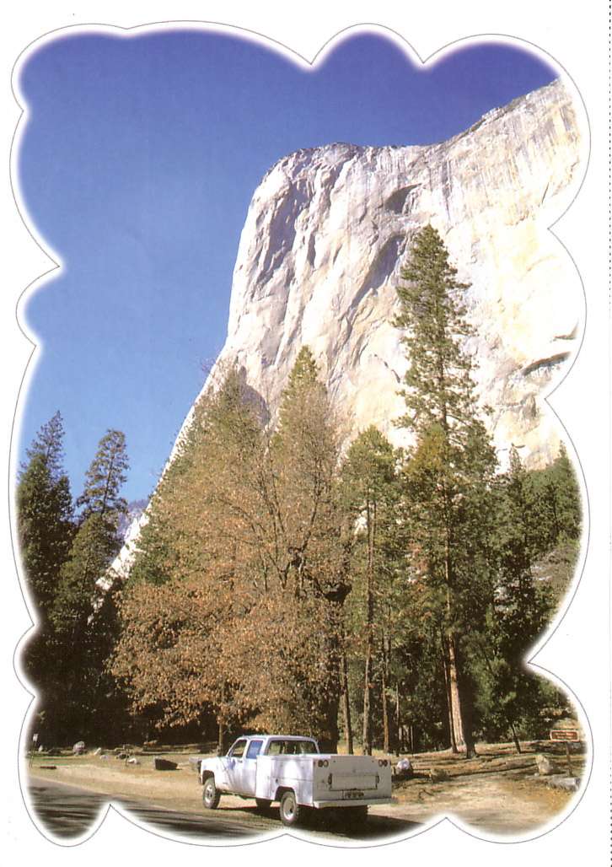
Use
The sun was shining and the birds were singing. Tom was driving his old truck through the forest.
Where can you read such sentences?
What do you think happened next?

Slide 13
Use 4
We use the past continuous to give the background information in a story, that is to set the scene.

Slide 14
Time Expressions
when
while
as

Slide 15
Join the sentences, using as, when or while, as in the example.
Tina was cooking. She burnt herself.
As/When/While Tina was cooking, she burnt herself.
2. Laura was making some tea. She dropped the kettle.
Mrs Jason was sitting in the garden. It started raining.
Peter was driving his car. He got a flat tyre.
She was walking in the park. A dog attacked her.

Slide 16
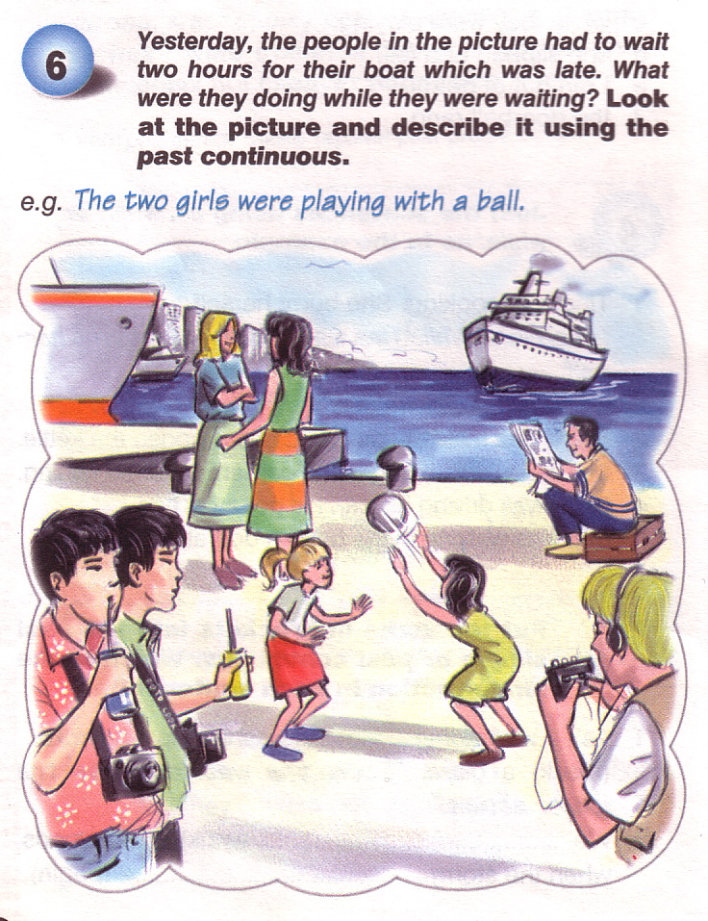

Slide 17
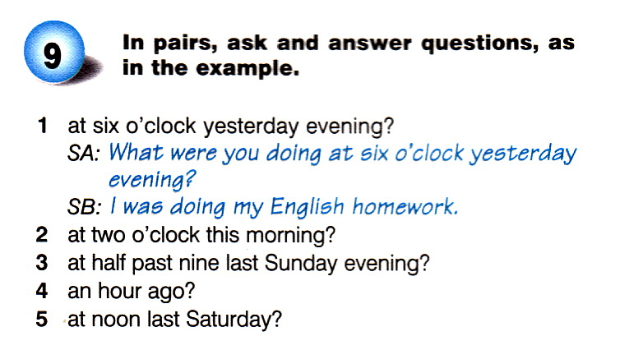

Slide 18
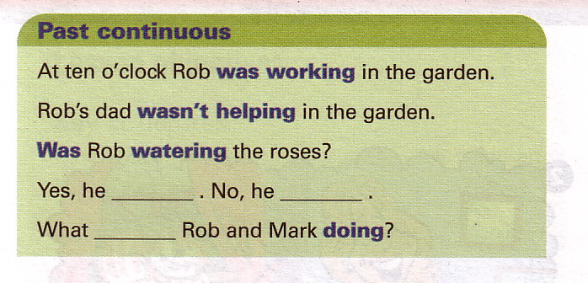

Slide 19
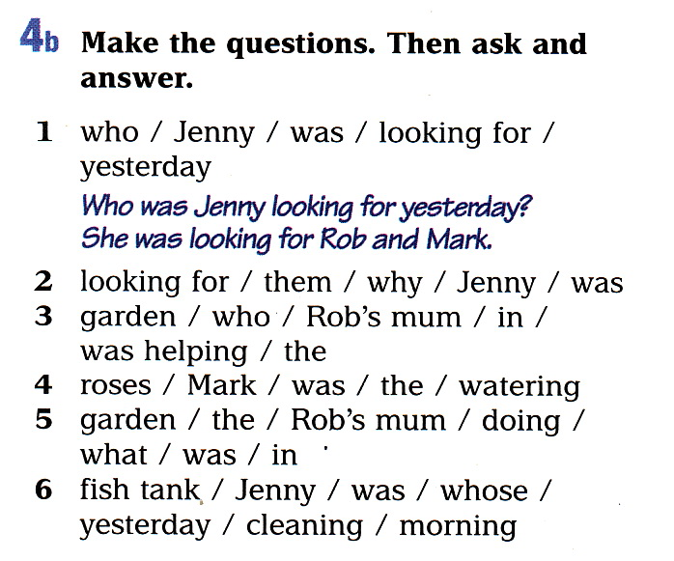

Slide 20
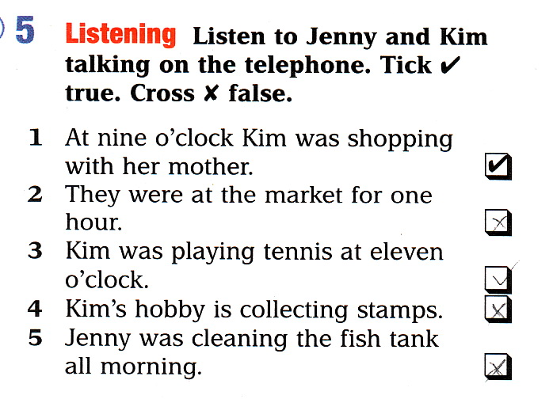

Slide 21
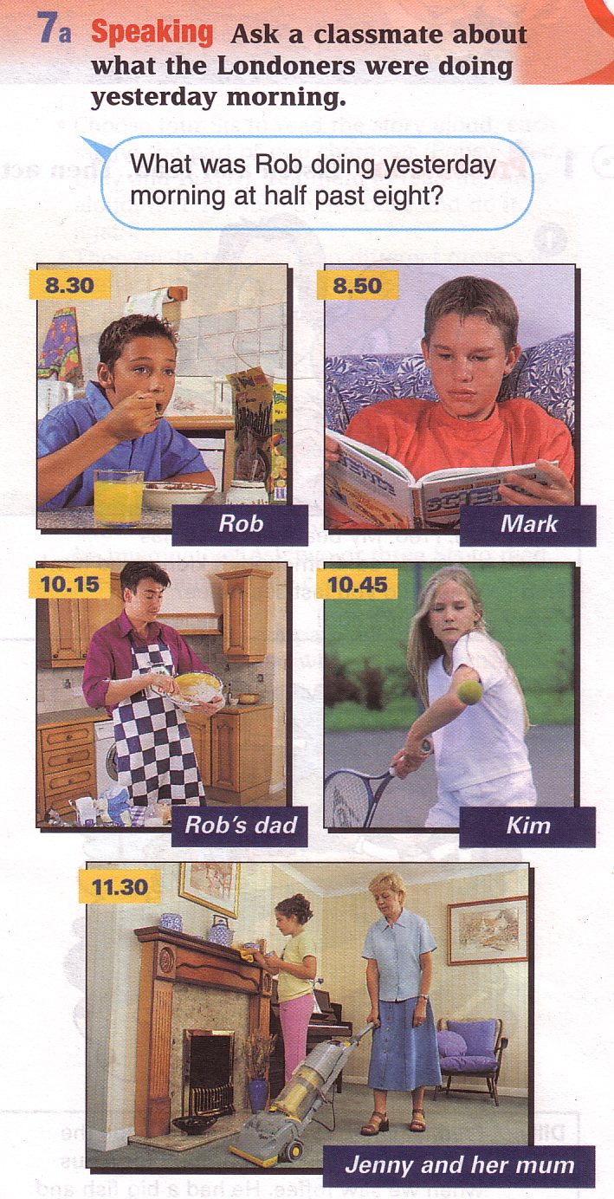

Slide 22
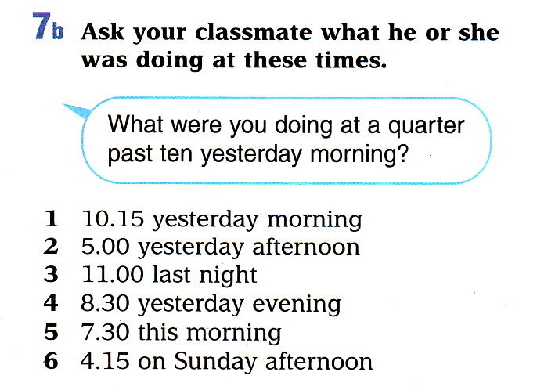

Slide 23
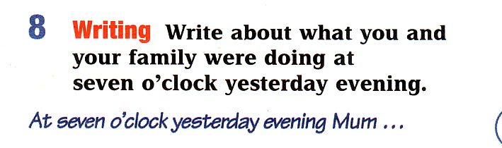

Slide 24
Referencias
Evans, V. y Dooley, J. (2003). Upstream. Beginner. Express Publishing.

