Slide 1
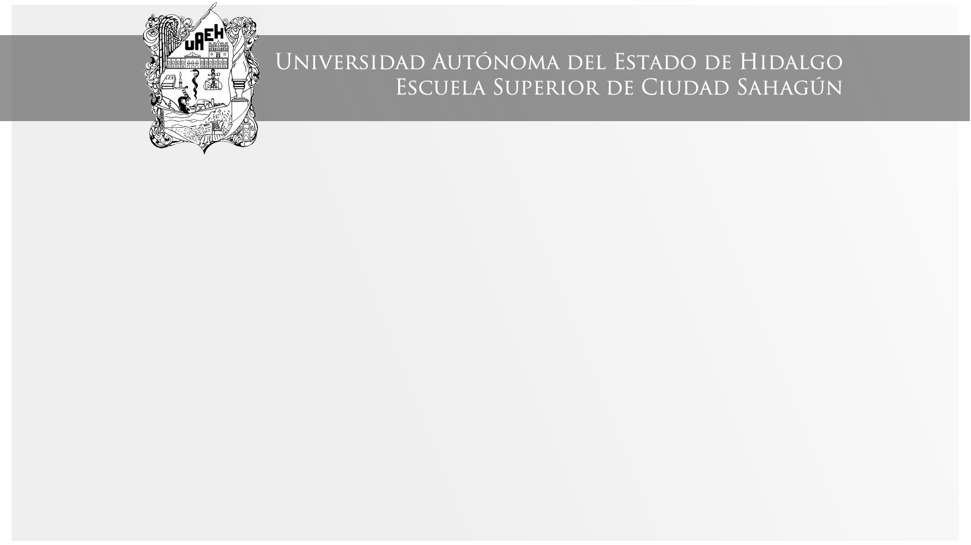
SUGERENCIAS
Área Académica: Ingeniería Mecánica
Profesor(a): Ma. E. Guadalupe Islas López
Periodo: ENERO_JUNIO 2017

Slide 2

SUGERENCIAS
Resumen
El poder dar sugerencias (should, shouldn´t) es el primer tema de la unidad I del PAI (programa académico institucional) de la materia causa-efecto en lengua extranjera.
Abstract
Suggestings (should, shouldn´t) is the first topic in unit I in PAI (programa académico institucional of the subject cause and effect in a foreigna language.
Keywords: should, shouln´t, sugerencias, causa-efecto, lengua extranjera.

Slide 3
Should/shouldn´t
We use should to say what the right/best thing to do is.
You should take regular exercise.
We use shouldn´t to say what isn´t the right/best thing to do.
You shouldn´t drop rubbish in the street.

Slide 4
Should/shouldn´t
We can also give suggestion with:
Why don´t you …?
I think it´s a good idea to …
I don´t think it´s a good idea to …

Slide 5
Should/shouldn´t
We can also give suggestion with,
Examples:
Why don´t you take regular exercise?
I think it´s a good idea to take regular exercise.
I don´t think it´s a good idea to eat junk food.

Slide 6
6th May 2013 Dear Linda, I´m happy to hear you that you are moving to Rome. I´m worried though, that you don´t have a place to stay when you get there. I think it´s a good idea to move to Rome, but I don´t think it´s a good idea to stay at a hotel because hotels are very expensive in Rome. Maybe you should wait a little while and go when you find a flat. Why don´t you ask your friends there to look for a flat for you? Hope to hear you from you soon. Love, Tracy

Slide 7
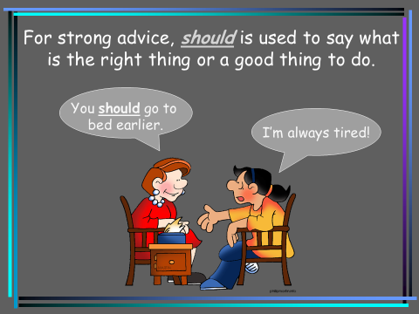

Slide 9
Referencias
Evans, V. y Dooley, J. (2000). Enterprise. Student´s book. Express Publishing.

