Slide 1
FUTURE TENSE
Área Académica: INGENIERÍA MECÁNICA
Profesor(a): MA. E. GUADALUPE ISLAS LÓPEZ
Periodo: ENERO_JUNIO 2017

Slide 2

FUTURE TENSE
Resumen
El tiempo futuro lo vamos a utilizar para eventos que se van a desarrollar en un tiempo posterior; puede utilizarse para decisiones, planes, intenciones.
Abstract
We are going to use future tense for events that they will happened after. We are going to use for decisions, plans or intentions.
Keywords: future, decisions, plans, intentions

Slide 3

FUTURE TENSES: WILL / GOING TO
I will travel to Japan next year → decision
I am going to study German at school→ plan

Slide 4
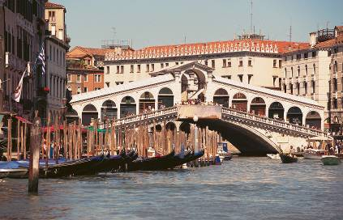
WILL/GOING TO
The Simple Future has two different forms in English: "will" and "be going to." Although the two forms can sometimes be used interchangeably, they often express two very different meanings as mentioned before.
I will probably go to Italy next Summer
I am going to fly to Italy next Saturday

Slide 5
Future Tense: Will→ Form
Affirmative: I will travel to Madrid in October
Interrogative : Will you travel by bus?
Negative : I will not travel - won’t
Will you travel by train or by bus?
I won’t travel by bus I will probably travel by train

Slide 6
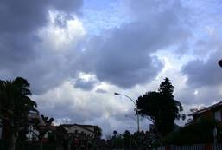
Future Tense: Uses of Will
1- Instant decisions: Ok, I’ll see you on Friday
2- Predictions based in what we think: It will rain in the evening
3- Promises and offers: Don’t worry, I’ll go and buy some food for you

Slide 7
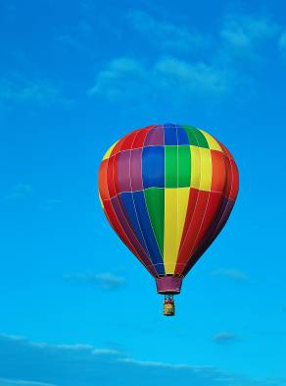
Future Tense: Going to→ Form
Affirmative: I am going to travel
by plane
Interrogative : Are you going to travel?
by plane’
Negative : I am not going to travel
by plane because I am
going to fly in a hot air
balloon

Slide 8

Future Tense: Uses of Going to
1- Future plans and intentions: I'm going to buy a new laptop computer next week
2- Predictions based in what we can see at the moment: Look at that car! it is going to crash into the lamp post

Slide 9
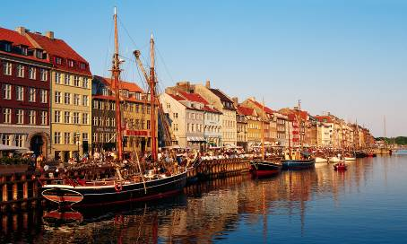
FUTURE TENSES
TIME EXPRESSIONS:
Tomorrow, next week, next month, next year,
I am going to travel to Copenhagen next year

Slide 10
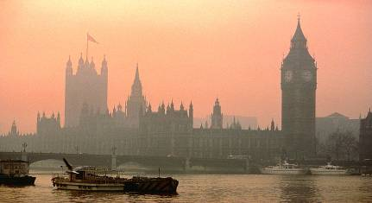
FUTURE TENSES WILL/GOING TO: COMPLETE THE SENTENCES
• A: Why are you holding a piece of paper? B: I …………………….. (write) a letter to my friends back home in Texas • A: I'm about to fall asleep. I need to wake up! B: I (get)………………… you a cup of coffee.
We are so excited about our trip next month to France. We ………………………. (visit) Paris, Nice and Grenoble. • I think he …………………. (be) the next British Prime Minister.

Slide 11
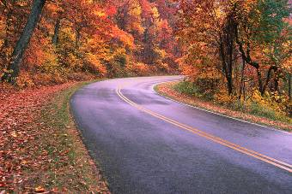
OTHER WAYS OF EXPRESSING THE FUTURE
The simple present and present progressive are also used to express future time. These are often used used in connection with schedules.
The train leaves at 6:00 a.m. tomorrow.
She is meeting a new client at six o’clock in the evening and she is travelling by byke through the forest.

Slide 12
Referencias
Redston, Ch. y Cunningham, G. (2010)
Face2face.Elementary student’s book.
Cambridge

