Slide 1
TEMA
Área Académica: INGENIERÍA MECÁNICA
Profesor(a): MA. E. GUADALUPE ISLAS LÓPEZ
Periodo: ENERO_JUNIO 2017

Slide 2

TEMA
Resumen
Usamos el verbo can para habilidades y permisos.
Abstract
We are going to use the verb can for abilities and permission.
Keywords: can, abilities, permission.

Slide 3


Slide 4

WHAT CAN SUPERMAN DO ?
FLY?
COOK?

Slide 5

HE CAN FLY
HE CAN’T COOK

Slide 6
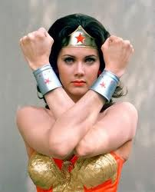
WHAT CAN WONDERWOMAN DO?

Slide 7

WHAT CAN WONDERWOMAN DO?
SING?
RUN VERY FAST?

Slide 8

SHE CAN’T SING.
SHE CAN RUN VERY FAST.

Slide 9
USES FOR CAN AND CAN’T

Slide 10

WE USE CAN TO SHOW ABILITY

Slide 11
WE ALSO USE CAN TO EXPRESS POLITE REQUESTS

Slide 12
CAN YOU CLOSE THE WINDOW PLEASE?

Slide 13
AND YOU, WHAT CAN YOU DO?

Slide 14
RUN?
READ?
WRITE?
COOK?
PLAY FOOTBALL?
SPEAK ENGLISH?

Slide 15
Referencias
Evans, V. y Dooley, J. (2003). Upstream. Beginner. Express Publishing.

