Slide 1
PAST SIMPLE BIOGRAPHIES
Área Académica: INGENIERÍA MECÁNICA
Profesor(a): MA. E. GUADALUPE ISLAS LÓPEZ
Periodo: ENERO_JUNIO 2017

Slide 2

PAST SIMPLE
Resumen
Vamos a utilizar el tiempo pasado para hablar de acciones que empezaron y finalizaron en el pasado.
Abstract
We are going to use past simple tense for actions that start and finish in the past. We can use it for biographies.
Keywords: biography, past, actions.

Slide 3
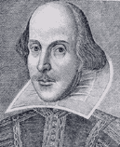
William Shakespeare 1564-1616

Slide 4
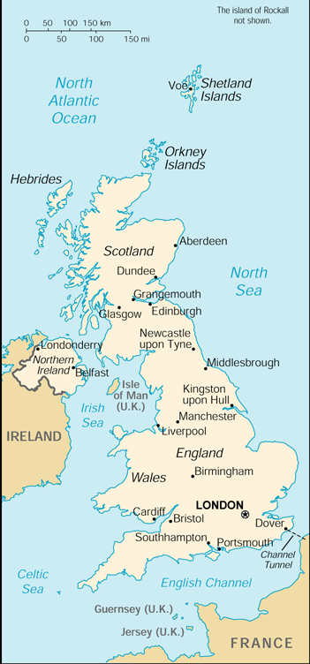
William Shakespeare Early years
Born in Stratford-Upon-Avon, England
Son of prominent town official
3rd child of 8 children
Received excellent education with heavy focus on grammar and literature

Slide 5
William Shakespeare Marriage and Family
Married at age 18 to Anne Hathaway (she was 26) who was pregnant with his child
1st child was daughter, Susanna-born in 1583
Twins, Hamnet and Judith born in 1585
Hamnet dies at age 11

Slide 6
William Shakespeare “Lost Years”
The period between 1585 and 1592 is known as the “Lost Years” because there are no documentary records of Shakespeare’s activities

Slide 7
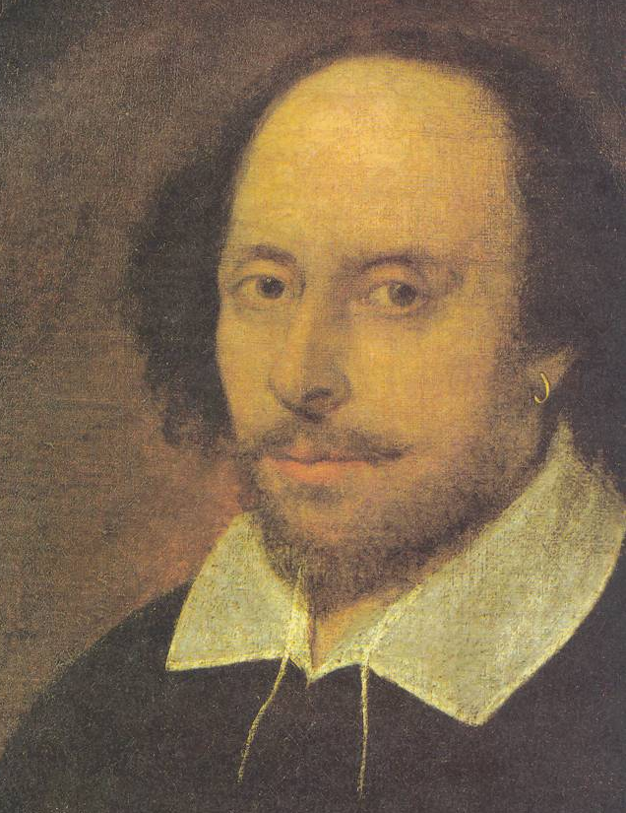
William Shakespeare Later Years
Moved to London around 1591 and became an actor
Worked with the Lord Chamberlin’s company of players, later known as the King’s Men

Slide 8
William Shakespeare Works of Literature
Along with acting, he also wrote some of the most renowned and studied literature written in the English language
Poems-famous for his sonnets
Plays-Comedies, Tragedies, and Histories

Slide 9
William Shakespeare Comedies
All’s Well that Ends Well
As You Like It
Comedy of Errors
Measure for Measure
Midsummer Night’s Dream
Taming of the Shrew
Much Ado About Nothing
Twelfth Night
Merchant of Venice

Slide 10
William Shakespeare Tragedies
Julius Caesar
Hamlet
Macbeth
Othello
Romeo and Juliet
King Lear

Slide 11
William Shakespeare Works of Literature
He wrote 37 very successful plays
His vocabulary was HUGE-somewhere between 17,000 and 34,000 words!
The estimated vocabulary of an educated person today is around 15,000 words

Slide 12
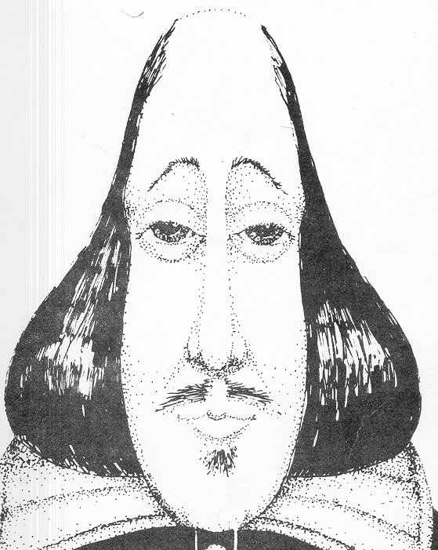
William Shakespeare Works of Literature
He had an amazing influence on our English language

Slide 13
William Shakespeare Later Years
Returned to Stratford around 1610 where he lived as a country gentleman
Wealthy-Owned one of the largest homes in town
Died in Stratford in 1616 at the age of 52. His death was a mystery. It is rumored that he drank too much and contracted a fever or that he died from a cerebral hemorrhage.

Slide 14
Referencias
http://libros.about.com/od/entrevistas/a/William-Shakespeare-Un-Resumen-De-Su-Vida-Y-Obra.htm

