Slide 1
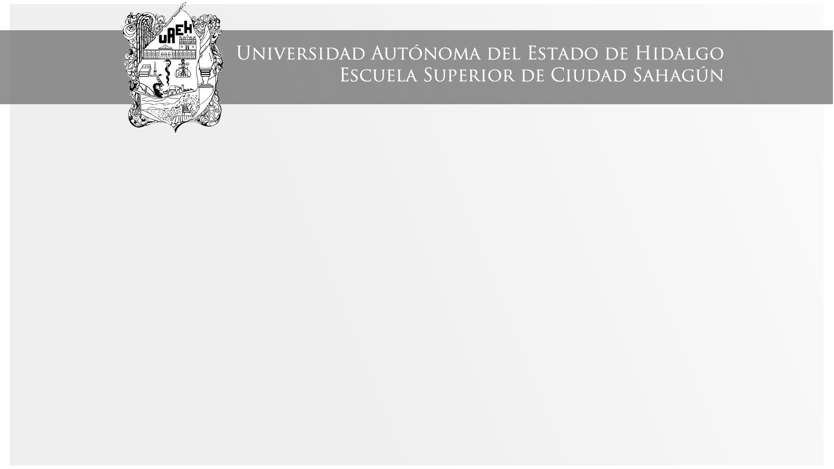
Tema: Simple Past
Área Académica: Licenciatura en Contaduría
Profesor: Manuel Saldaña Franquis
Periodo: Enero – Junio 2017.

Slide 2

ABSTRACT:
Use the Simple Past to express an idea that started and finished at a specific time in the past. Sometimes, the speaker may not actually mention the specific time, but they have one specific time in mind.
RESUMEN:
El pasado simple se utiliza para expresar una idea que inició en una acción y terminó en un momento específico en el pasado. Algunas veces, el hablante puede realmente no mencionar el tiempo específico, pero sí tienen un tiempo específico en mente.

Slide 3
KEY WORDS:
Was, were, regular and irregular verbs.

Slide 4

USE 1 Completed Action in the Past
Examples:
I watched a movie yesterday.
I didn't see a play yesterday.
Last year, I travelled to Japan.
Last year, I didn't travel to Korea.
Did you have dinner last night?

Slide 5

USE 2 A Series of Completed Actions
Examples:
I finished work, walked to the beach, and found a nice place to swim.
He arrived from the airport at 8:00, checked into the hotel at 9:00, and met the others at 10:00.
Did you add flour, pour in the milk, and then add the eggs?

Slide 6

USE 3 Duration in Past
Examples:
I lived in Brazil for two years.
Paul studied French for five years.
They sat at the beach all day.
They did not stay at the party all the time.
We talked on the phone for thirty minutes.
A: How long did you wait for them? B: We waited for one hour.

Slide 7

USE 4 Habits in the Past
Examples:
I studied French when I was a child.
He played the violin.
He didn't play the piano.
Did you play a musical instrument when you were a kid?
They never went to school, they always skipped class.

Slide 8

USE 5 Past Facts or Generalizations
Examples:
She was shy as a child, but now she is very outgoing.
He didn't like tomatoes before.
Did you live in Texas when you were a kid?
People paid much more to make cell phone calls in the past.

Slide 9
Write the past forms of the irregular verbs.

Slide 10
Complete the table in simple past

Slide 11
Put the sentences into simple past.
We move to a new house. → ______________________________
They bring a sandwich. → ________________________________
He doesn't do the homework. → __________________________
They sell cars. → _______________________________________
Does he visit his friends? → _______________________________

Slide 12
Put the verbs into the simple past:
Last year she (eat) ______ate_______ snails.
It (be) _______________________ fantastic.
I (visit) _______________________ lots of interesting places. I(be) _________________________ with two friends of mine.
In the mornings we (walk) _________________ in the streets of London.
In the evenings we (go) ___________________ to pubs.
The weather (be) ________________________ strangely fine.
It (not / rain) _________________ _________ a lot.
But we (see) ____________________________ some beautiful rainbows.
Where (spend / you) _____________________ your last holiday?
They (be) _______________________ _______ very tired yesterday.

Slide 13
Write "Was“ or "Were“:
1.- The sweater ___________ nice.
2.- The students __________ very clever.
3.- But one student __________ in trouble.
4.- We __________ sorry for him.
5.- It ___________ a nice though.

Slide 14
Referencias
Arrandal, H. (2015). Evidence from Exercises of Executive Stock Options. Indiana University: Indianapolis, USA.
Davis, P. (2014) Make It Real Professional
UAEH: México.
Rogers, M. (2010) face2face pre-intermediate. Cambridge: UK
www.perfect-english-grammar.com

