Slide 1
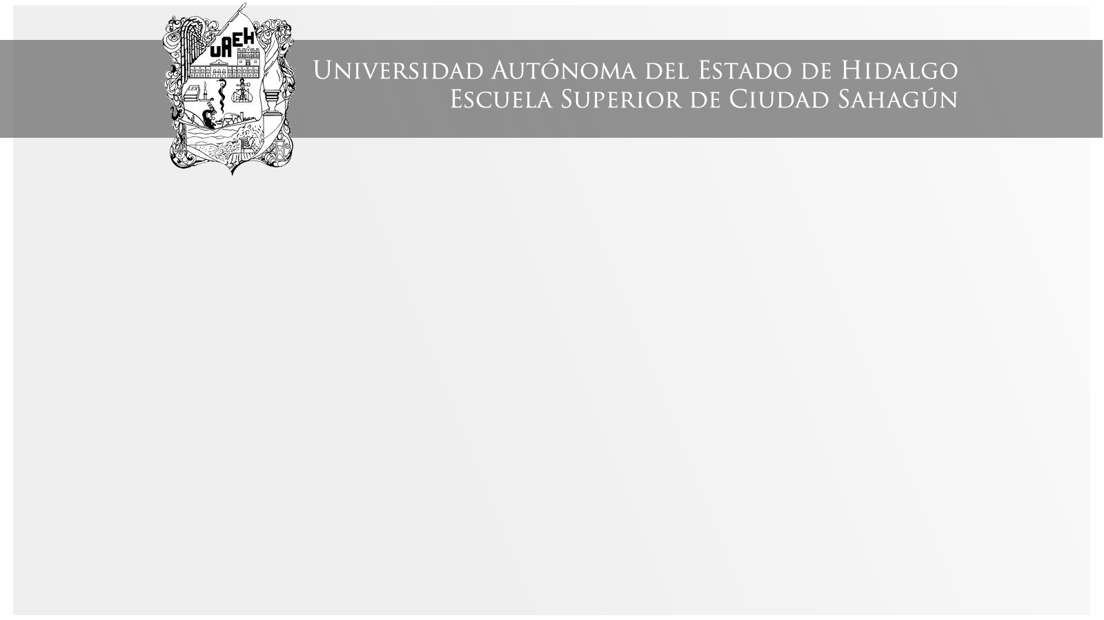
U_1_Present_Perfect
Área Académica: Licenciatura en Contaduría
Profesor(a): María del Socorro Piedra Mayorga
Periodo: Enero – Junio 2017

Slide 2

Present Perfect
Abstract
We use the Present Perfect to say that an action started at an unspecified time in the past and continue at the present time
Resumen
El presente perfecto se usa para hablar sobre una acción que inició en un tiempo no específico en el pasado y continua en el tiempo presente.

Slide 3
Key Words
Have, has, past participle of the vebs.

Slide 4
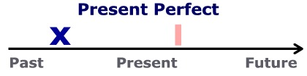
Use 1: actions in the past which have a connection to the present.

Slide 5
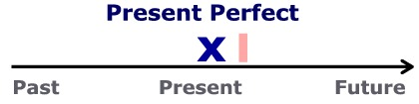
Use 2: for recently completed actions..

Slide 6
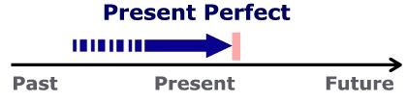
Use 3: for actions beginning in the past and still continuing.

Slide 7

Present Perfect
Affirmative
+ has/have + vpp.
e.g.
Alex has seen “Power Rangers”
We have ridden the bikes for 2 hours and we are tired.

Slide 8
Present Perfect
Interrogative
Have/Has + + vpp ?
Has she studied for the exam?
yes, she has / no, she hasn´t
Have they drunk tequila?
yes, they have / no, they haven´t

Slide 9
Present Perfect
Negative
+ have/has + not + vpp
She hasn´t eaten escamoles
They haven´t written the letter
I haven´t driven a truck

Slide 10
Exercise
Mariana _____ _____ (eat) snake meat.
_____ you _____ (see) that movie?
Telma and Rose _____ _____ (drive) lately
I _____ _____(not/go) to Europe
____ Horace _____ (drunk) champagne?

Slide 11
e-pages
You can exercise this tense on next e-pages
https://www.ego4u.com/en/cram-up/grammar/present-perfect-simple/exercises
http://www.really-learn-english.com/present-perfect-exercises.html

Slide 12
References
Davis, P. (2014) Make It Real Professional UAEH: México.
(EF, s.f.)
(Today, 2017)

